Slide 1
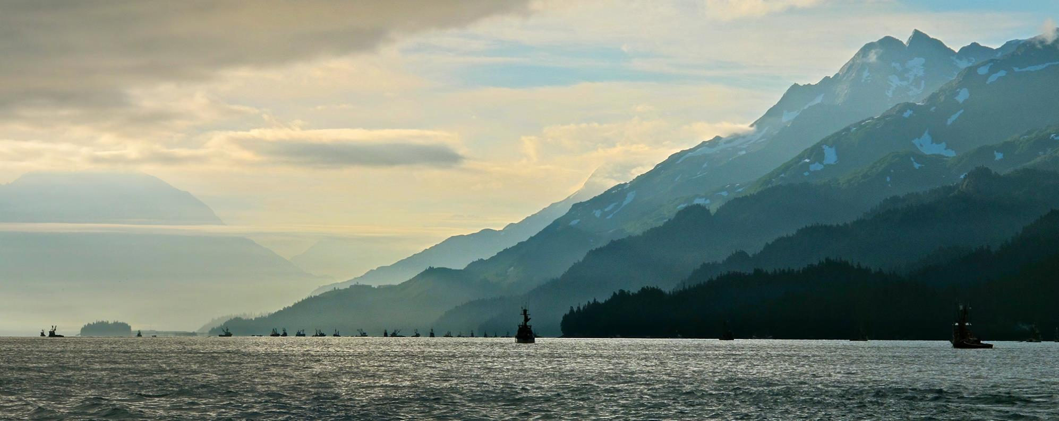
ASMI Seafood Technical Program Overview October 2018
Michael Kohan, Seafood Technical Director
Notes:
Within ASMI, my role is to be the science liaison and support for the seafood industry by effectively communicating the technical topics that affect the value of Alaska’s seafood and the livelihood of the harvesters and processors that rely on the fisheries. The program continues to grow and mature in different areas as we strategize how best to serve the industry. Today, I am here to give you a brief overview of the program and an update on the past year’s activities as well as future endeavors. I encourage you to find me during the meetings this week or come to the seafood technical meeting tomorrow if you want to hear more about the activities of the program or if you are interested in collaborating on a future project.
Alexa’s Reminder: As has been discussed at Directors and Domestic Meetings, please use this opportunity as a “Close the Loop” session. In addition to your traditional program update, please call out or follow up on any major tasks that were given to your program at the last All Hands. This can either be a separate slide or can be integrated into the presentation, but make sure you can demonstrate program responsiveness to requests.

Slide 2
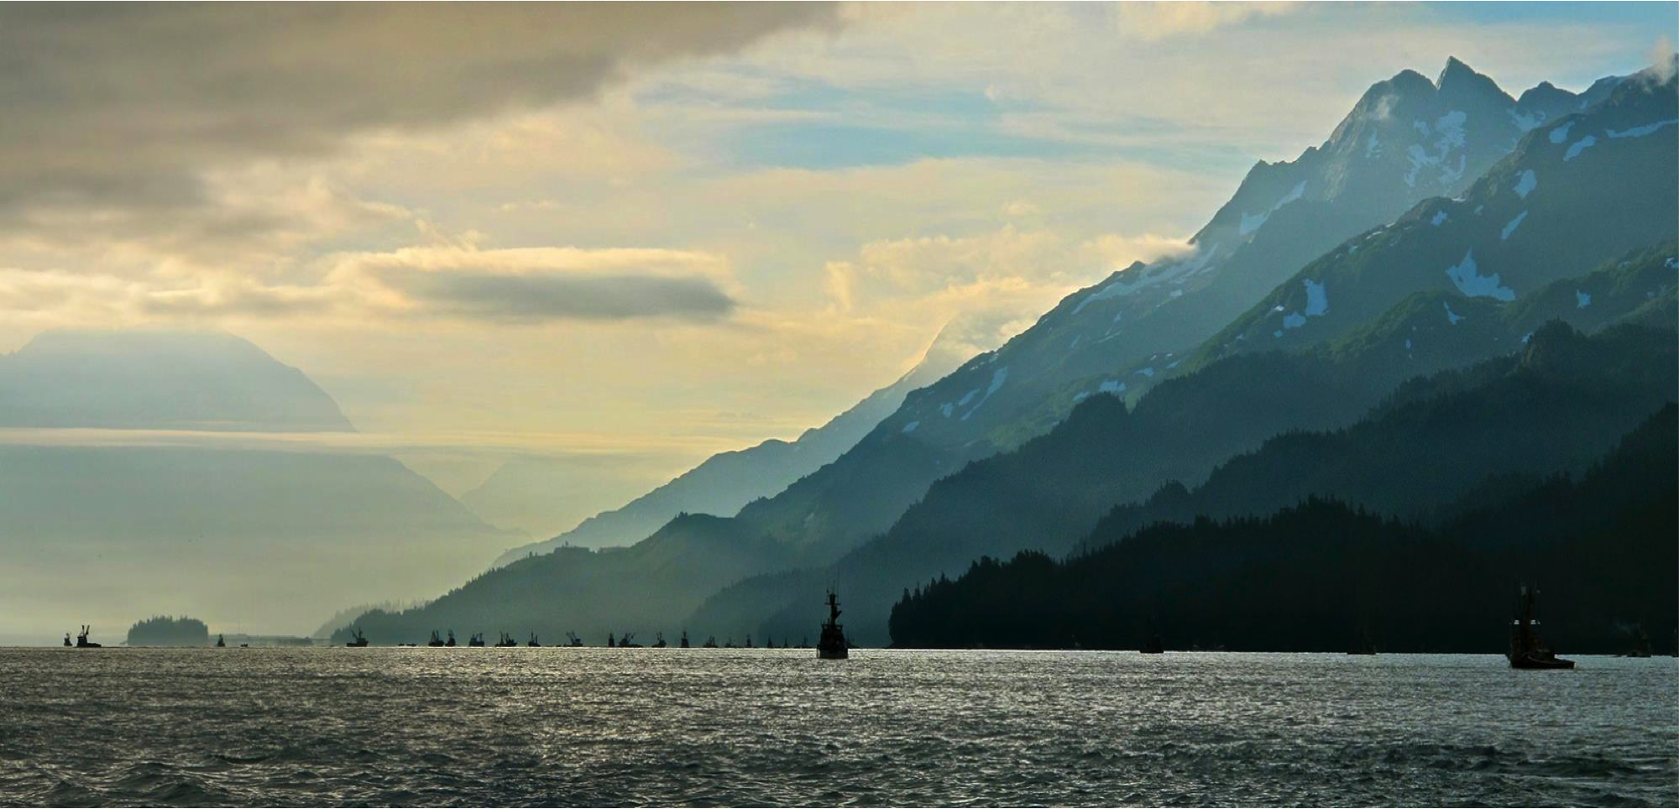
Seafood Technical Program
QUALITY
NUTRITION
SAFETY
SCIENCE
Notes:
The goal for the program is to connect with the industry and provide resources in multiple technical categories including: seafood quality, safety, traceability, utilization, nutrition, and promoting innovative opportunities in science and research for Alaska seafood. An important component of the technical program is to provide support for ASMI’s marketing programs on technical matters. This past year, I have worked to find more opportunities for collaboration not only within ASMI’s programs, but also with research institutions, ngos, partner seafood industry groups, local Alaska community seafood advocates, and diet and nutrition experts.

Slide 3
Seafood Technical Overview
SUPPLIED MATERIALS
Outreach and educational material related to Alaska seafood
TRADE EDUCATION
Outreach and educational opportunities in seafood technical issues
for the industry
APPLIED INVESTIGATIONS
Research opportunities related to the quality and value of Alaska seafood
Notes:
*** change pictures in circles…
Supplied Materials
develop content, materials, and provide guidance for technical issues of concern
develop materials for industry on quality and processing techniques
---------
Trade Education
support educational opportunities to promote the seafood technical field
- collaborate with the fishing industry to develop cohesive strategies for the sustainable growth of Alaska seafood
---------
Applied Investigations
seafood quality and nutrition
product development
processing issues
environmental issues

Slide 4
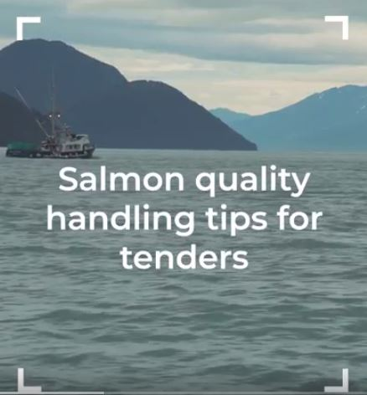
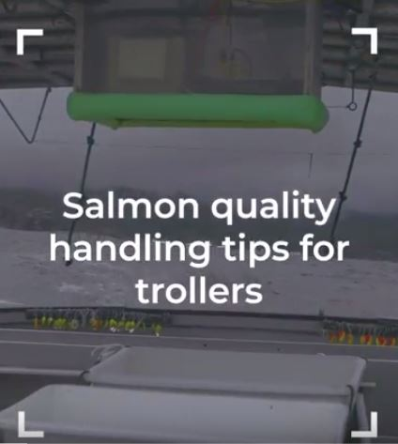
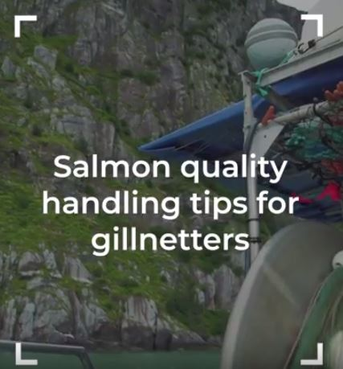
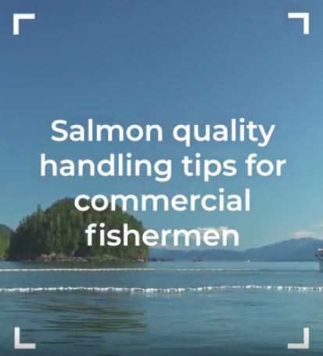
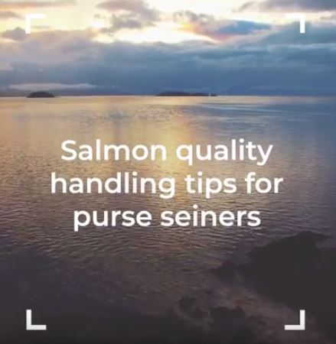
Supplied Materials
Outreach and educational material related to Alaska seafood
Notes:
Hoping to have a video clip here… .

Slide 5
Trade Education
Outreach and educational opportunities in seafood technical issues for the industry
USDA: NUTRITIONAL DATABASE
ALASKA OCEAN CLUSTER / SYMPHONY OF SEAFOOD / OSU SURIMI SCHOOL / PFT
WEBSITE CONTENT FOR NUTRITION AND QUALITY
ASMI STAFF GUIDANCE / SUPPORT FOR MESSAGING ON TECH ISSUES
Notes:
Chalky halibut issue

Slide 6
Applied Investigations
Research opportunities related to the quality and value of Alaska seafood
SEA GRANT/FITC: CHITOSAN & RTE CRAB LISTERIA RESEARCH
PCCRC GRANT: POLLOCK & HALIBUT NUCLEOTIDE RESEARCH
SiRF/UCONN: ALASKA SALMON CONSMPTION FOR CANCER RESEARCH
Notes:
The use of chitosan as an edible coating was evaluated for its antimicrobial activity against Listeria monocytogenes on the surface of ready-to-eat (RTE) Dungeness crab (metacarcinus magister) products.
In this investigation, we aim to gather key information regarding dietary fish consumption patterns in BCS with respect to current guidelines. We anticipate that BCS are not meeting current guidelines overall or specifically for fish consumption.

Slide 7
THANK YOU
Notes:
Continue to build relationships to create opportunities for research and outreach projects to increase the value of Alaska seafood.
Continue to revise and develop technical materials based on industry needs.
Continue to grow and provide a platform for nutrition research and messaging for Alaska seafood.
Continue to support seafood safety training and education.
Thank you all for wearing your ASMI hats and like I said before, if you are interested in hearing more about these projects or would like to collaborate, please feel free to flag me down this week.

