Slide 1
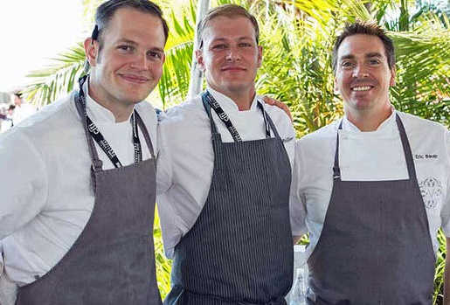
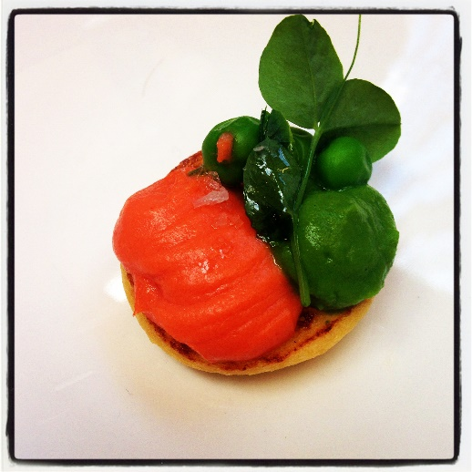
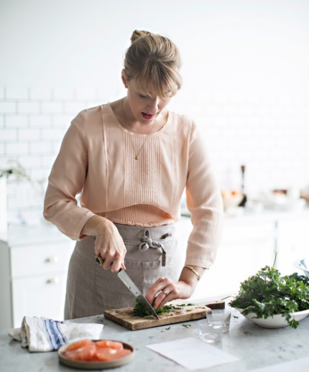
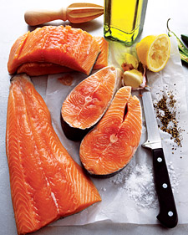
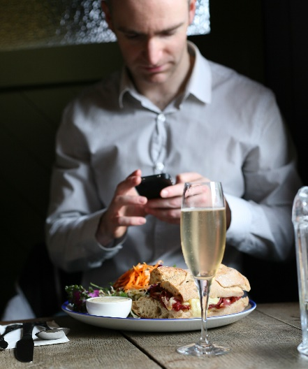
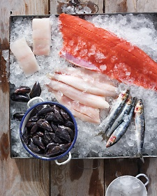
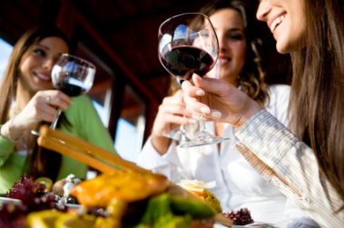
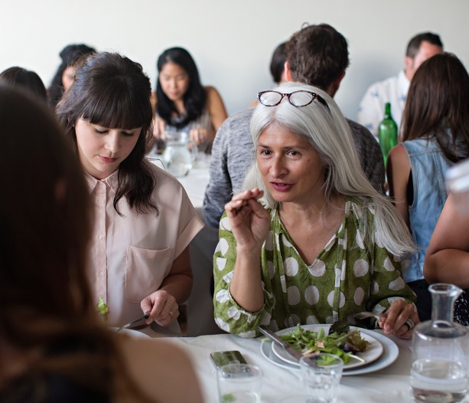
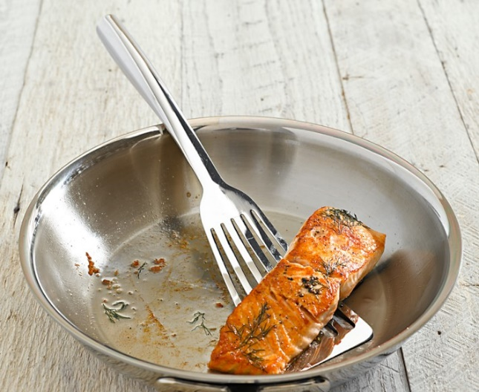
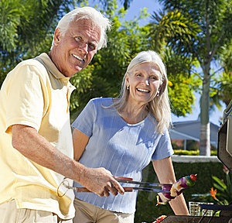
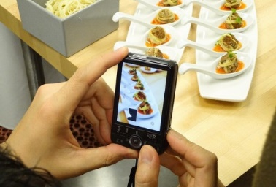
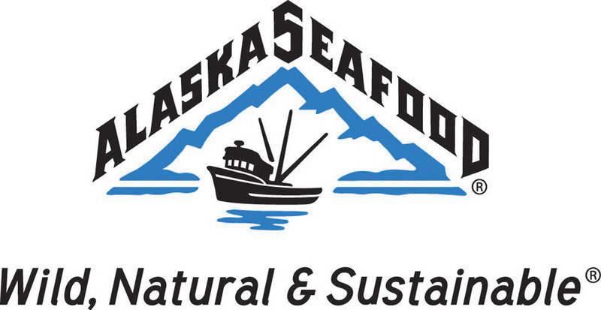
ASMI/Edelman Consumer Public Relations FY’15 Activity Highlights (January – April 2015) and FY ‘16 Recommendations
May 5, 2015 – Board Meeting

Slide 2
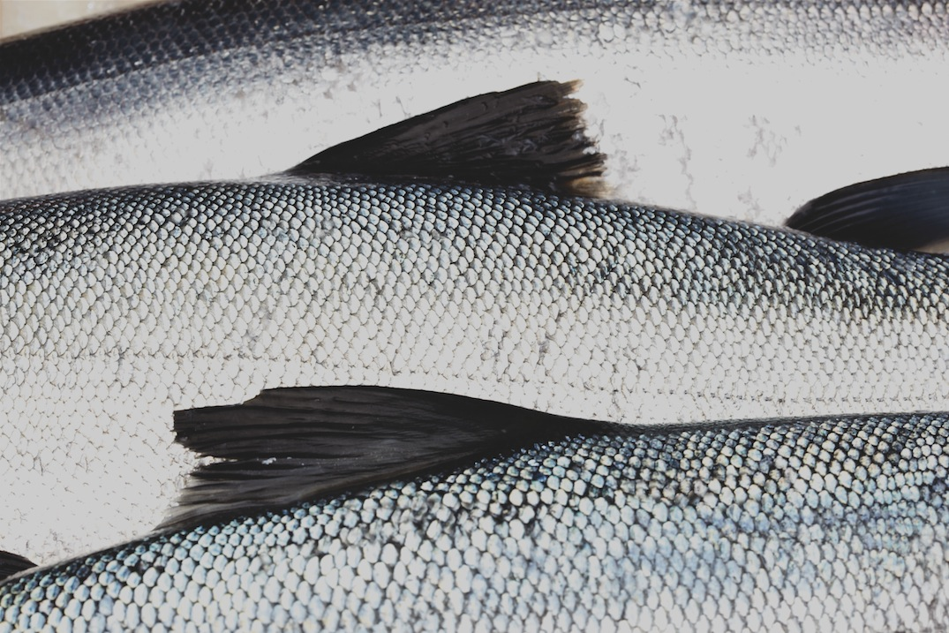
FY’15: Objectives
Drive increased brand recognition and preference for Alaska Seafood.
Tell the Alaska story: illustrate that Alaska is the amazingly pristine place with the highest standards in sustainability – the place you WANT your food to come from.
Integrate “Alaska” into foodie discussions, recipes and vernacular among culinary tastemakers and culinary focused media.
Stress nutrition messaging to further awareness around the benefits of eating Alaska seafood.
Educate and influence consumers through media relations placements to drive increased seafood consumption inside and outside of the home.
Target a younger and more diversified consumer.

Slide 3
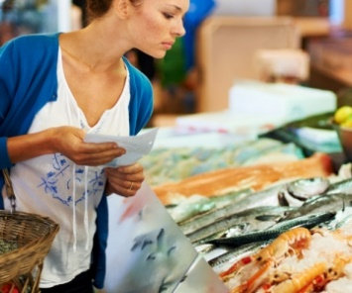
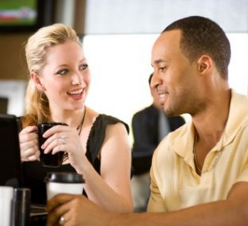
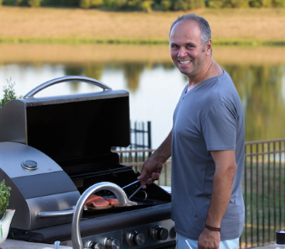
AUDIENCE: FY’15 and FY‘16
MILLENIALS, XERS (18-36)
Driver: Healthy lifestyle, foodie mentality
75 Million
Intrigue of Alaska
Adventurous eaters and culinary supporters
Motivated to do what’s best
Sustainable practices important
Looking for value; smart purchase
Aspiring home chefs
BABY BOOMERS (50+)
Driver: Long life, good looks
75 Million
Intrigue of Alaska
Taste is important
Red meat alternative
Right for the environment
I look good when I serve to others
Seafood lovers seeking tasteful, healthy proteins
Younger audiences want healthy, yet responsible food adventures, they are cooking more, and they rely on digital and social media for information
Boomers eating healthy want to stay that way, look good, extend life

Slide 4
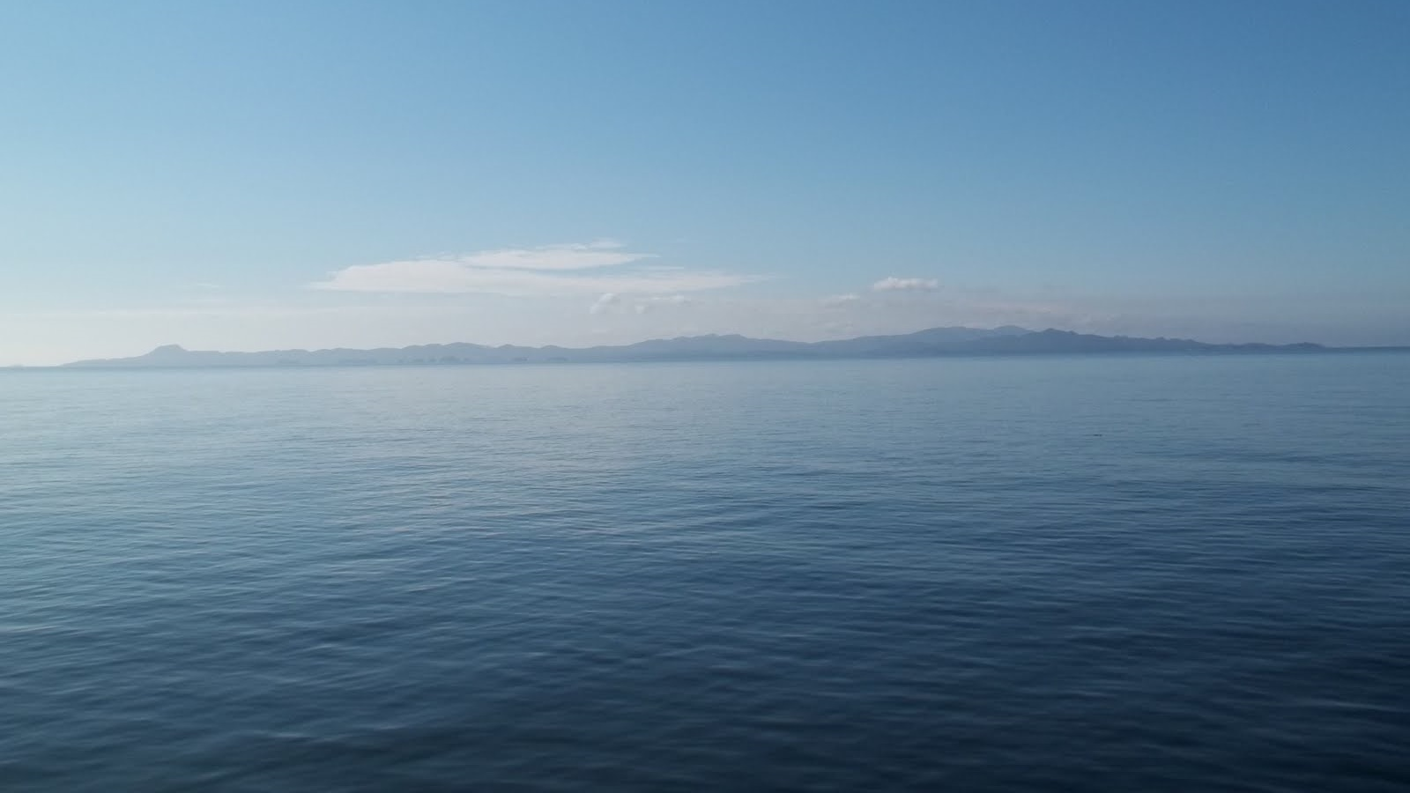
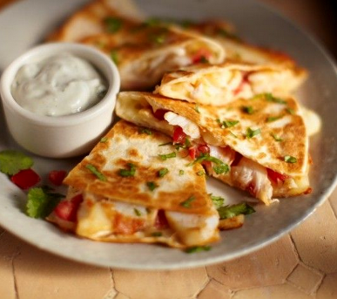
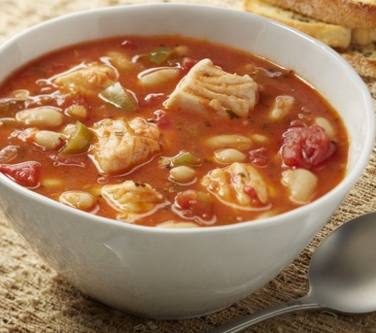
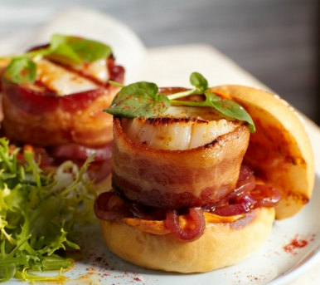
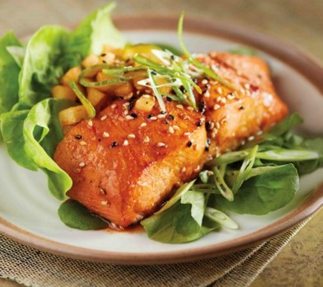
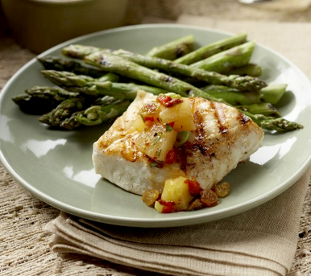
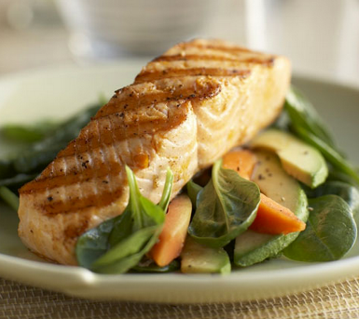
FY’15: STRATEGIES: WHERE WE HAVE BEEN FOCUSING
TELLING THE ALASKA STORY: WHERE YOU FIND THE PUREST, WILD SEAFOOD ON THE PLANET
Media relations, events, social media management
Booking media and chefs for FAM trips
EMPHASING THE SUPERIOR TASTE OF ALASKA SEAFOOD TO CULINARY and ELITE MEDIA
Media relations, social media efforts
NYC events – Tasting Table, Food Network test kitchen
New collateral – Seafood for All Seasons guide, Salmon guide
HIGHLIGHTING NUTRITIONAL INFORMATION TO ILLUSTRATE THE BENEFITS OF EATING ALASKA SEAFOOD
Media relations, social media efforts
Uber Athlete Program – securing media opportunities for Ryan and Sara Hall

Slide 5
FY ‘15 – Results to Date (February – April)
Secured an estimated 793 million impressions through media relations placements in Associated Press, New York Times, RealSimple.com, Allrecipes.com and more.
7.1 million impressions through recipe-centric blogger program resulting in 40 posts and 40 Alaska seafood recipes.
Booked more than 30 editors to attend upcoming ASMI tasting event in NYC from top tier national outlets including Food&Wine, Bon Appetit, Martha Stewart Living, Redbook, YahooFood, FamilyCircle, Real Simple and more.
For Summer FAM visits, secured seven editors from FoodNetwork.com, Bon Appetit, Refinery29, Glamour, Food Republic, Thrillist and Food Network/Cooking Channel and four top chefs: Tom Douglas, Eric Donnelly (RockCreek), Andrew D'ambrosi (Bergen Hill, NYC), and Elizabeth Falkner.
Notes:
Screenshots of coverage

Slide 6
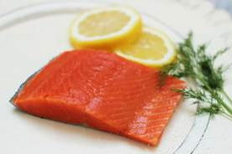
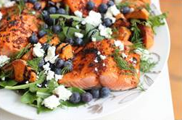
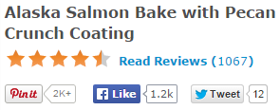
FY ‘15 – Sample of Coverage to Date

Slide 7
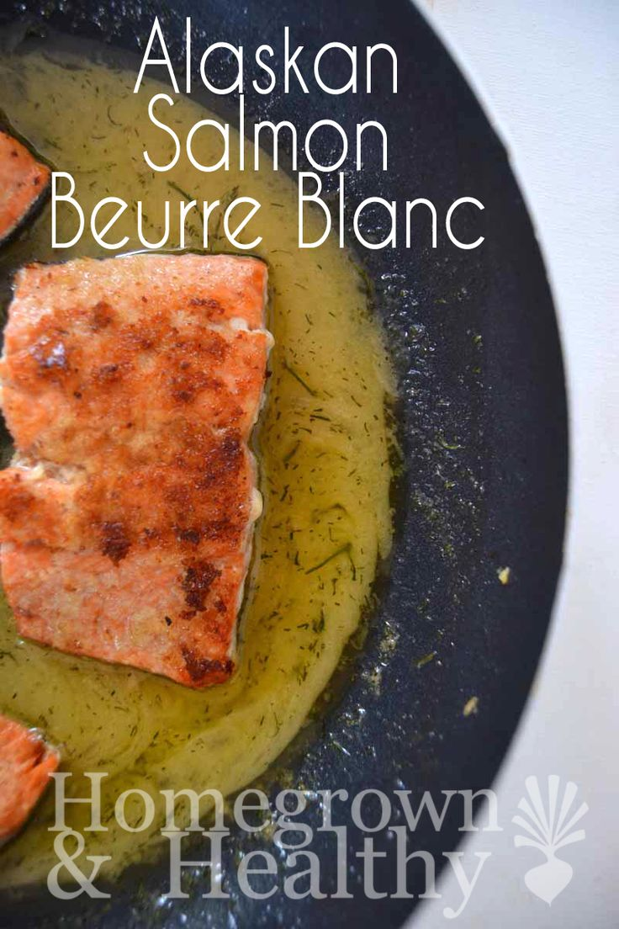
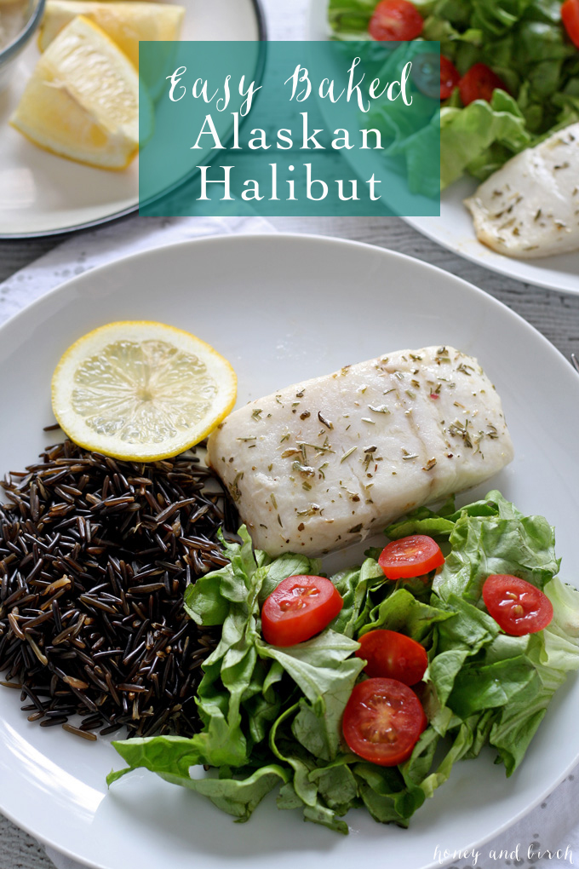
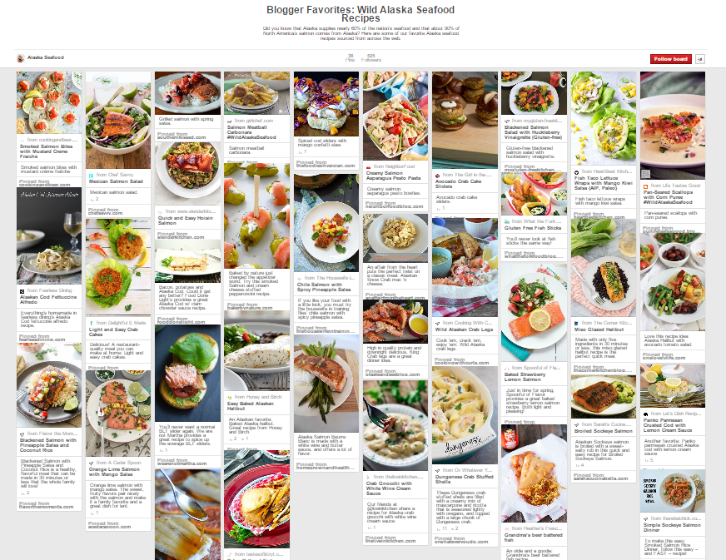
Culinary Blogger Program
Objectives: Target millennials, drive increased recognition for Alaska Seafood; Secure coverage of Alaska Seafood recipes.
Program: Collaborated with Clever Girls Collective for 40 food, health/nutrition blog posts including recipes for a canned, fresh or frozen Alaska seafood species.
Coverage was posted over four weeks (March 12 to April 10); timed to leverage Lent, weeknight meals and kid-friendly recipes. Many included the Seafood for all Seasons guide.
Results: 7.1 million impressions
40 blog posts, 40 Facebook posts, 80 tweets, and 40 Pinterest pins.
Amplified coverage via dedicated ASMI Pinterest board and shared social posts on ASMI’s Facebook and Twitter channels.
“I always choose wild caught over farm raised seafood, but now I will search for wild Alaska seafood whenever possible.”
“If you're unsure which way to turn when you're looking for seafood, a good place to start is by looking for the words Alaska seafood.”

Slide 8
Creative Materials & Releases
Seafood for All Seasons Harvest Calendar, Salmon Guide and Harvest Opening Press Releases
Objectives: Drive excitement for Alaska species, recipes and year-long availability and highlight nutritional benefits.
Program:
Designed Seafood for All Seasons calendar and developed press release announcing the start of Alaska halibut and black cod seasons; distributed both to hundreds of reporters.
Created a robust salmon guide featuring recipes, species details, frozen and canned techniques to debut at the Tasting Table event in NYC on April 30.
In mid-May, will distribute the salmon guide and press release announcing the kickoff of salmon season, and ASMI branded items to hundreds of media outlets nationwide.
Results: 21 million impressions to date through secured coverage; 278 million additional impressions from press release distribution
Recipes for the 2015 Halibut Season (It Starts Today)
“Seafood season begins this weekend in Alaskan waters. Fresh-caught Alaskan halibut and black cod have returned from their spawning grounds and are coming soon to a supermarket near you. “

Slide 9
Media Relations
Objectives: Target local and national media, increase recognition for Alaska Seafood, secure coverage of Alaska Seafood recipes, nutritional benefits and related content.
Program: Created news engine calendar to support monthly touch points with media. Announcements and pitches to date include:
Superbowl (February) – Pitched recipe ideas to 175 editors and bloggers.
Lent and Valentine’s Day (February) – Pitched recipe ideas to hundreds of editors and bloggers.
Ryan and Sara Hall (March) – Conducted outreach highlighting nutrition messaging pegged to LA Marathon targeting LA media, regional media, and national fitness outlets; secured interviews and recipe coverage in Pittsburgh Post-Gazette, NJ.com and The Active Times.
Easter (March) – Shared recipe ideas and Seafood for All Seasons calendar with short lead media.
Cinco de Mayo (April) – Shared Cinco de Mayo recipes with food bloggers, editors and reporters.
Salmon Season Kickoff (April/May) – Shared varietal details, recipes, nutritional information and photos with national media; secured six Associated Press stories.
Results: 776 million impressions to date
Q&A: Elite Runners Ryan and Sara Hall Share Top Nutrition Strategies
“At first we weren't sure how to best prepare frozen fish, so we used the instructions on wildalaskaseafood.com.”
7 Seafood Staples That Will Transform Your Supper
“Loaded with omega-3s and vitamin D, wild Alaskan salmon is one of the most environmentally-friendly seafood choices consumers can make…”
Salmon patties offer tasty source of fish oil during Lent
“Today is Ash Wednesday, the first day of Lent, and a good day to pick up a can of wild Alaskan salmon.”

Slide 10
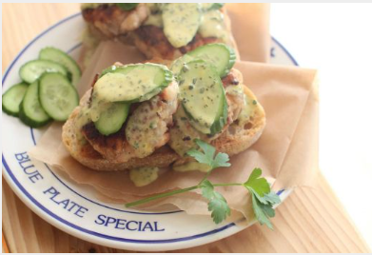
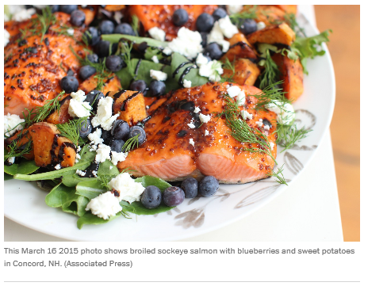
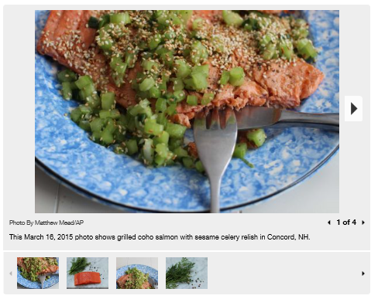
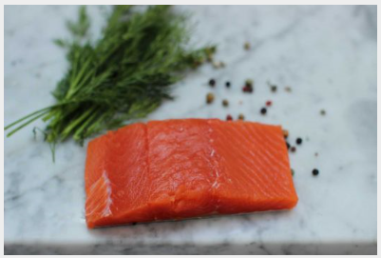
Top Story: Associated Press
Overview: Associated Press ran an in-depth feature on Alaska salmon, as well as five separate stories on each species with an accompanying recipe and photos. The features were picked up in a variety of top tier outlets including Washington Post, Yahoo! News, ABC News, Houston Chronicle, among others.
Number of hits to date: 132 articles via 42 different outlets
Total impressions to date: 597 million
HEADLINES:
“Simple Guide (with Recipes) for Mastering Salmon Seasonality”
“A Seasonal Salmon Primer: King Salmon (also Called Chinook)”
“A Seasonal Salmon Primer: Coho Salmon (also Called Silver)”
“A Seasonal Salmon Primer: Sockeye Salmon (also Called Red)”
“A Seasonal Salmon Primer: Pink Salmon”
“A Seasonal Salmon Primer: Keta Salmon (also Called Chum)”

Slide 11
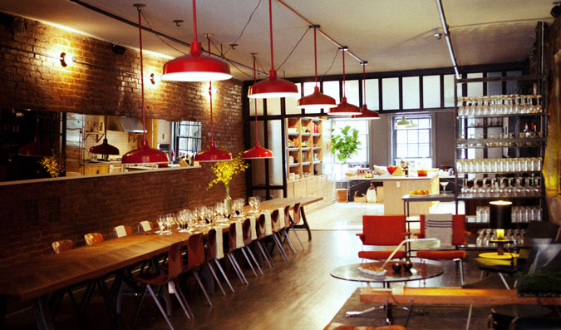
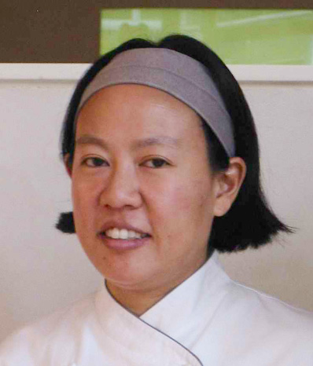
NYC Tasting Event and Tasting Table Partnership
Objectives: Increase recognition for Alaska Seafood; Integrate “Alaska” into food centric media for timely stories and future coverage; Encourage salmon recipes/features and highlight nutritional messaging.
Program: Host tasting event for top-tier media at Tasting Table in NYC on April 30; After the event, reach millennial foodies via a media integration reaching Tasting Table’s influential audience (2MM subscribers, 1MM social followers)
Chefs Anita Lo, Kim Sunee and Kirsten and Mandy Dixon will demo salmon recipes to educate attendees for future stories.
ASMI will provide species information and Alaska seafood facts; each guest will receive the salmon guide and ASMI branded materials.
Results:
More than 30 top-tier media are slated to attend, including reporters from Oprah, Real Simple, Martha Stewart, Thrillist, Prevention, Family Circle, Businessweek, Redbook, Food & Wine, Bon Appetit and Fine Cooking.
Following the event, Tasting Table will feature a gallery of images; in May the site will feature Alaska Seafood creative and distribute custom advertorials and email blasts to its large subscriber base

Slide 12
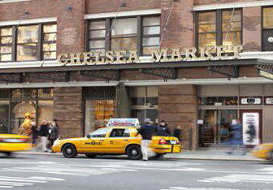
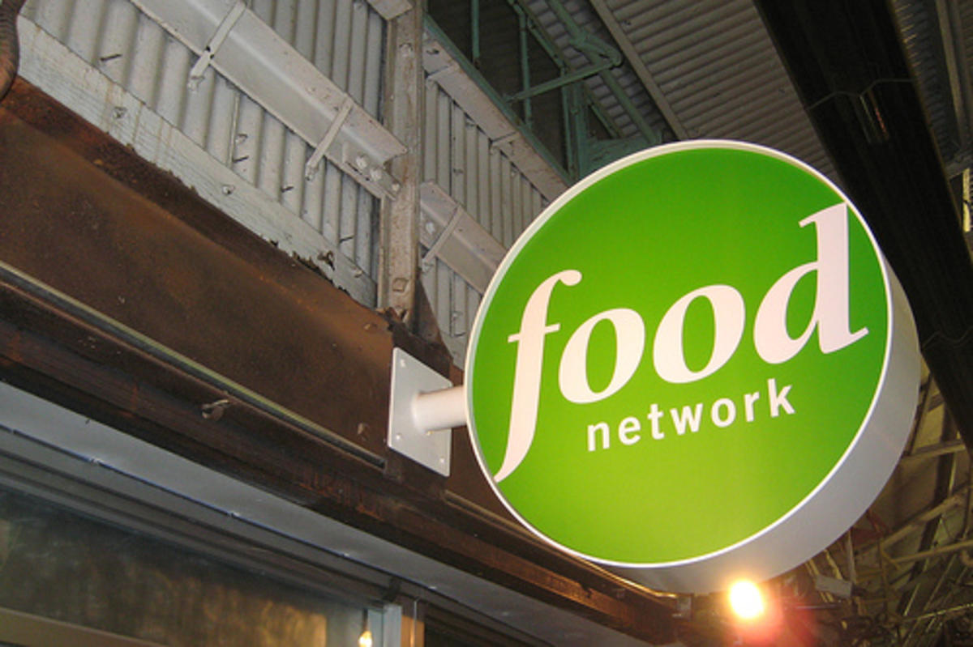
Food Network Test Kitchen Demo
Objectives: Drive increased recognition for Alaska Seafood; Integrate “Alaska” seafood and salmon into future Food Network segments.
Program: Host interactive demo and lunch for Food Network employees
On May 1, ASMI will host an Alaska seafood/salmon focused lunch and learn at the Food Network test kitchen in NYC featuring chefs Kirsten and Mandy Dixon
The chefs will demo three salmon recipes showcasing techniques for fresh, frozen and canned salmon to educate attendees for future segments and posts; ASMI will provide Alaska seafood facts and information.
Results:
25 Food Network editors, producers and social media leads are expected to attend to learn about Alaska seafood.

Slide 13
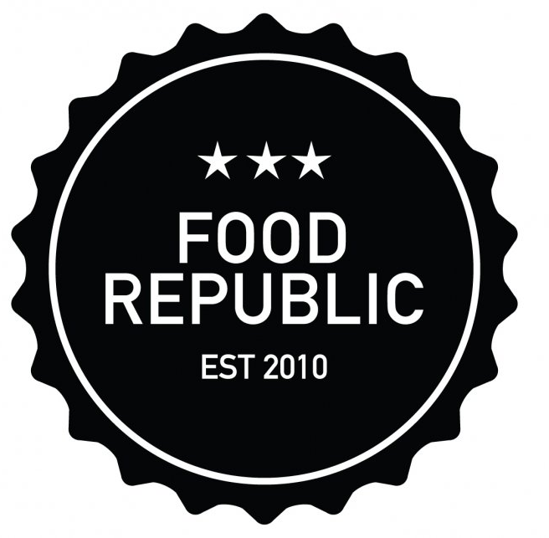
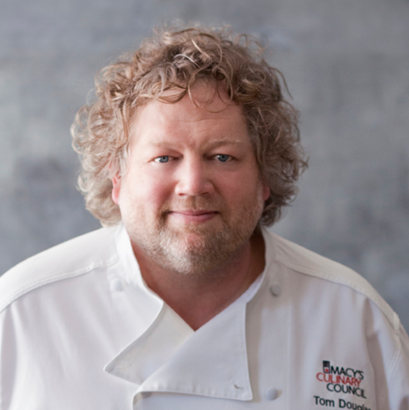
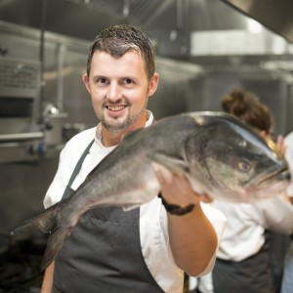
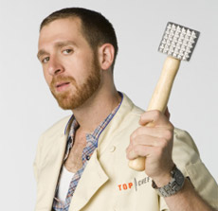
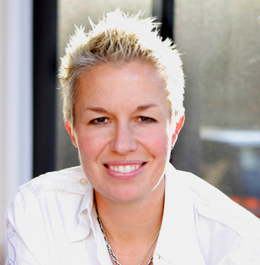
FAM Trips – July and August 2015
Objectives: Drive increased recognition of Alaska seafood; Integrate “Alaska” into food-centric media for timely stories and future coverage; Encourage salmon recipes/features
Program: Provide top-tier national media and culinary influencers a deep education on the purity of Alaska seafood via three FAM trips this summer.
Culinary: Kirsten and Mandy Dixon’s Tutka Bay Lodge will provide a backdrop for culinary demonstrations and lessons about the region’s bounty.
Sikumi Boat: Two trips will take guests on a first-hand “sea-to-table” experience with fishing, visits to local processors, cooking and more.
Results:
Seven editors from top-tier national media: FoodNetwork.com, Bon Appetit, Refinery29, Glamour, Food Republic, Thrillist and Food Network/Cooking Channel.
Four chefs: Seattle chefs Tom Douglas and Eric Donnelly (RockCreek), Andrew D'ambrosi (Bergen Hill, NYC), Elizabeth Falkner and Anita Lo.

Slide 14
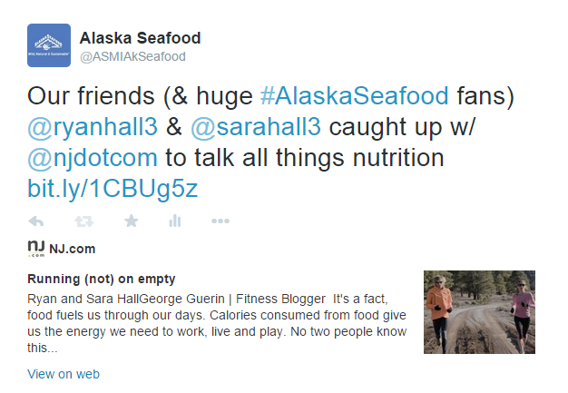
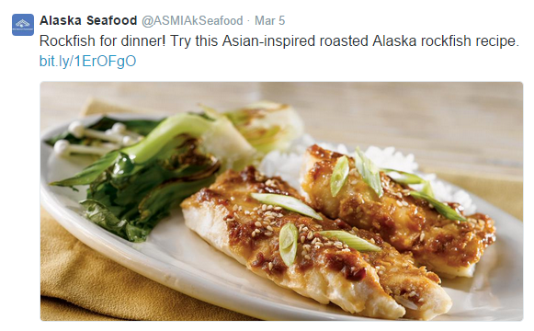
Digital and Social Efforts
Objectives: Improve Brand Recognition, Expand Online Presence, Create a Two-Way Dialogue, Support PR, Sales and Marketing by cross-promote marketing activities such as events, blog posts, etc. on Facebook, Instagram and Twitter.
Program: Developed and executed monthly social editorial calendars for Facebook, Instagram and Twitter including upcoming campaigns, events, news and content, Monitored and flagged proactive engagement opportunities on Facebook, Instagram and Twitter, Provided monthly reporting and analysis.
Results:
Twitter: Over the last six months, average engagements per post have increased 90% from 4.4 to 8.4. The usage of #fishfridays and #salmonsaturdays has increased by 20%.
Facebook: Over the last six months, average link clicks have increased 24% from 72 to 89 when compared to the prior six months.
Instagram: Over the last three months, average engagements per post have increased 15% from 27 to 31 when compared to the prior three months. Note: There were no Instagram posts made in Dec 2014 – Jan 2014.
Online conversations have increased by 17% across blogs, Twitter, and forums when looking at April 2014- Sept 2014 versus October 2014 – April 2015.

Slide 15
FY’15: Budget
$652,000 Total for January – June 2015
$58,000/month – fees - $232,000 spent to date
$304,000 – OOPs total - $150,000 spent to date including upcoming NYC event, travel for FAM trips, media materials, paid blogger program.

Slide 16
FY’16: Objectives
Drive increased brand recognition and preference for Alaska Seafood through media relations and social media programs that illustrate the Alaska story.
Further showcase the Alaska Seafood taste experience through culinary media and influencers.
Educate consumers with articles, programs and events focused on nutrition, sustainability, frozen vs. fresh debunking, and the business of Alaska Seafood.
Support ASMI’s mission to increase the economic value of Alaska seafood.

Slide 17
FY’16: Insights
Dietary Guidelines for Americans (DGAC) suggest adults should eat eight ounces of seafood per week – about double what most get. New dietary guidelines will be released in late 2015 presenting an opportunity to stress the benefits of seafood. Early findings from DGAC indicate: “To supply enough seafood to support meeting dietary recommendations, both farm-raised and wild caught seafood will be needed” which will make nutrition a larger focus for farm-raised supporters as well.
Frozen seafood is one of the fastest-growing retail seafood categories. 84% of consumers are likely to purchase frozen seafood (Alaskaseafood.org). Americans spend only 30 minutes per day on average cooking (Organization for Economic Cooperation and Development) making the 15-minute COOK IT FROZEN!® technique an ideal method.
Demand for wild-caught fish, especially salmon, remains high. This often leads to mislabeling because retail outlets know that consumers are more likely to want to buy wild and often sell farmed Atlantic salmon as wild king or sockeye (New York Times) . With 90-95% of wild salmon in the U.S. coming from Alaska, there is an opportunity to educate consumers that asking for “Alaska” is an easy way to guarantee they are eating “wild.”
While wild seafood is often referenced in recipes, the region is regularly omitted. There is an ongoing opportunity to educate chefs, food writers and bloggers to include the Alaska name.
Sustainable seafood appeared on the National Restaurant Association’s annual report on Food Trends for 2015. The “What’s Hot Culinary Forecast” revealed “locally sourced meat and seafood” as the number one trend, “environmental sustainability” as number three, and “sustainable seafood” as number eight.

Slide 18
FY’16: Strategies
Nutrition: Preempt the release of the DGAC guidelines with nutritional messaging.
Frozen: Leverage convenience and affordability data to initiate new momentum for frozen product and COOK IT FROZEN!® techniques.
Wild: Hammer hard on the powerful, unspoiled imagery of Alaska seafood and fisheries to make Alaska synonymous with “wild”.
Culinary: Place Alaska Seafood at the center of the modern food movement at regional events.
Sustainability: Exploit superiority of Alaska Seafood to lead and innovate the sustainability discussion.

Slide 19
Program Recommendations: Tactics
ONGOING MEDIA RELATIONS/NEWS ENGINE:
Create eye catching/informative press materials to educate media about the Alaska seafood bounty, nutritional facts, species information and recipe ideas.
Further tell the Alaska story through captivating spokespeople – fisherman, biologists and chefs.
Stress nutritional information year round to get ahead of DGAC and collaborate with Seafood Nutrition Partnership for nutrition study/press push timed with National Seafood Month in October.
Release new consumer data regularly to drive coverage – e.g. frozen stats, seafood consumption, nutrition.
Conduct outreach surrounding frozen seafood and frozen techniques with new recipes and chef interviews.
Continue to pitch hundreds of media nationwide tied to Alaska seafood milestones, holidays and trends:
July – August 2015: Salmon harvest season; Summer entertaining and grilling
September – October 2015: National seafood month outreach; nutritional information; Back to school easy dinner recipes; fall favorites and comfort foods including seafood chowders
November – December 2015: Holiday entertaining
January – February 2016: Healthy seafood recipes for New Years resolutions; seafood nutrition; Lent
March – April 2016: Lent; Easter and spring favorites; halibut and black cod harvesting season begins
May – June 2016: Summer entertaining and grilling; salmon harvest season begins

Slide 20
Program Recommendations: Tactics
SEAFOOD EVENTS NATIONWIDE:
Host an Alaska seafood dinner/tasting event for media and influencers in NYC.
Introduce more media and influencers to Alaska seafood with events in foodie cities nationwide – Los Angeles, Chicago, Charleston/Atlanta, Seattle. *multiple events would require additional budget
Hold frozen vs. fresh blind seafood taste test events around the country for media and consumers. Collaborate with new and existing chef partners to deliver frozen messaging and demos. *would require additional budget
Secure placement at nutritional focused events like FNCE to reach health editors and RDs; Focus on National Seafood Month as a major news peg for events this fall focused on nutrition.
SPEAKERS BUREAU: Develop a speakers bureau program featuring nutrition, sustainability, culinary experts as the voice of seafood nationwide.
Work with existing RDs and new RDs to tell the Seafood Nutrition story and pitch health focused media; Continue to work with athletes like Ryan and Sara Hall and Kikkan Randall to tell the nutrition/training story.
Create sustainable panel discussion at Martha Stewart American Made event in NYC in November to include ASMI representatives.

Slide 21
Program Recommendations: Tactics
INFLUENCERS AND CHEF RELATIONSHIPS:
Engage with chefs and influencers who appeal to media, millennials and boomers to raise awareness for Alaska seafood.
THE ALASKA STORY – Events, Media Relations and Story Telling:
Collaborate with in-state team to execute Summer ‘15 trips and book Summer ‘16 FAM trips to educate more chefs, media and influencers about Alaska seafood. *travel for media and chefs not included in budget
Coordinate with Alaska tourism groups for larger seafood focus at events in New York and California.
Emphasize “what local means to Alaska” through interviews with fishermen and fishing families.
Share the fishing business story through infographics that show impact of Alaska on the rest of US businesses.

Slide 22
Program Recommendations: Tactics
ONGOING DIGITAL AND SOCIAL MEDIA EFFORTS:
Strategy-Driven Community Management and Content Creation:
Develop passionate Facebook, Twitter, Instagram communities through engaging social content.
Surprise and Delight:
Pinpoint social Alaska seafood lovers and surprise on a weekly basis with Alaska Seafood swag.
Blogger/Social Influencer Program:
Partner with influencers to create content that will also be targeted (paid support) to ASMI’s key audiences.
Paid Media: *would require additional budget
Boost top-performing content to maximize post engagement with the Alaska Seafood social community.
Roll out a paid media plan to guarantee social reach, drive fan acquisition and drive website traffic.

Slide 23
Estimated Budget
Recommend $69,000 monthly retainer/fee to cover consumer and social efforts
Consumer PR and Digital/Social: July ‘15 – June ‘16
PROGRAM | TACTIC | ESTIMATED SUBTOTAL
Monthly PR Retainer | Consumer PR, Digital and Social planning, strategy and execution | $69,000/month
Press Materials | Design and distribution of new materials | $15,000
Paid Social Media Programs | Blogger network program; basic social amplification | $35,000
NYC Event | NYC culinary media event/activities | $70,000
Speaking Engagement/Trade Shows | Speaker travel, demo costs | $27,000
Travel | Travel to staff NYC event, speaking engagements and FAM trips | $25,000
Total Consumer PR OOPs |  | $172,000
Total Fees – Consumer PR and Social/Digital – $69,000/month |  | $828,000
 |  | $1,000,000
*Additional OOP budget required for events outside of NYC, speaking engagements, FAM travel for media/chefs and paid social optimization/management

