Slide 1
FY16 Communications Budget Alaska Seafood Marketing Institute
Tyson Fick Communications Director May 5, 2015

Slide 2
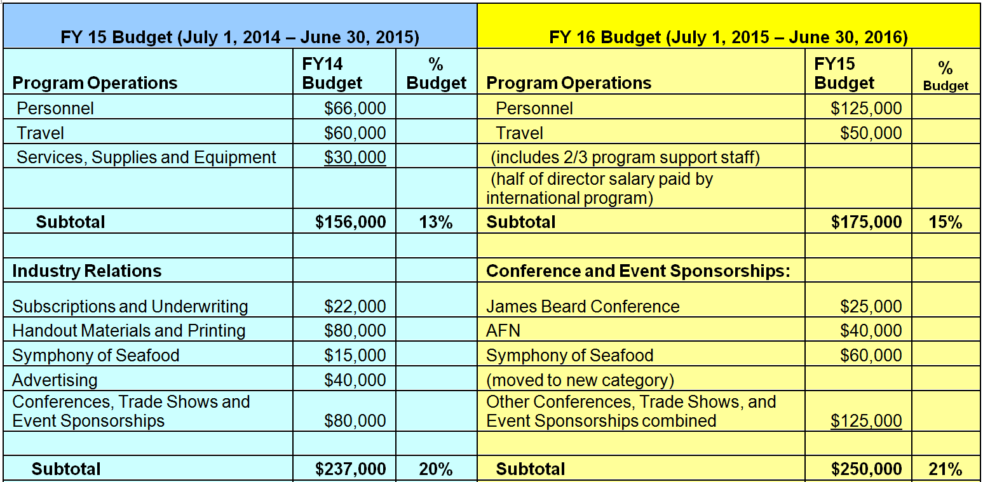
FY2016 Communications Budget

Slide 3
FY2016 Communications Budget Continued

Slide 4
Communications Budget Categories
$1.2M Total
Program Operations - $175K
Conferences & Event Sponsorships - $250K
Fleet, Seafood Industry, & In-state Advertising,
& Promotions - $200K
Domestic Consumer PR Support - $140K
Alaska Stock Photo, Video, & Profiles - $80K
Printing, Materials, & Swag - $55K
Media Tour Expenses - $60K
Contract Labor Support - $240K

Slide 5
Communications Budget Highlights
Key Changes in FY16
Reorganized to reflect activities
Support personnel allocated to Communications
Working with the Domestic Consumer PR contract
Leverage value
Integrate messaging
Removed reserve fund

Slide 6
Communications Budget Highlights
Committee Emphasis / Input for FY16
Sockeye salmon
Canned salmon
(Sockeye salmon was the highlighted species at media events last week)
Social Media Integration
Look for efficiencies
Notes:
Sockeye was the highlighted species at NYC events last week

Slide 7
Communications Program Challenges
Huge and varied audience (US and international consumers + In-state + industry + government)
In-state user group politics
Unclear direction on depth of involvement in political realm
Lack of dedicated Communications Program committee
Fishermen can be hard to reach, sometimes counter-productive to efforts
Tasked with non-strategic one-offs
Organizing and sharing photo and video content
Changing priorities
RFM
Notes:
Fragmented audiences and messages combined with a limited amount of resources (time + money) risks diminished or diluted returns on messaging.

Slide 8
Communications Program Opportunities
A “deep bench”
Increased program staff capacity
Coordinating messaging with all programs
Growing pool of talented Alaska chefs, photographers, artists, fishermen, and fisheries organizations with which to partner
Partnerships such as #eatalaska project with Alaska Grown leads to increased brand leverage
Increased return on relationships
Notes:
Though we have a number of challenges, we have an even greater number of opportunities.
Alaskan-ness. Long-standing institutional knowledge. Broader geographic base
Strong team with established and growing relationships and networks in Alaska

Slide 9
Communications Program Opportunities
The Alaska story
Program plan with defined audiences and strategically selected tactics
New tactics: Fleet newsletter, fishermen ambassador, #eatalaska
Upcoming industry research to include fishermen
Extensive video and photo library resources
Budget limitations = “do fewer things better”

Slide 10
ASMI Organizational Challenges
Dysfunctional .org website
Legislature funding uncertainty
Lower ex-vessel prices due to economic factors could lead to fleet discontentment
RSDA chaos
Reactive stance derails substantive work
Staff, contractor, and agency turnover
Lack of organization-wide strategic planning process

Slide 11
ASMI Organizational Opportunities
Continuing positive traction on US fisheries
Healthy fish stocks
Opportunity to improve synergy between JNU and SEA
Growing domestic appetite for sustainable foods
Good fit into consumer and epicurean trends
New agency, new ideas
New .org website as a better tool to reach audiences

Slide 12
Communications Program: Looking Ahead
Continue to see leadership & partnership
‘Do fewer things better’
Cutting through the noise
Clearly defined input from Committees and Board will be an asset moving forward

Slide 13
Questions?

Slide 14
Thank you!

