Slide 1


Certified Seafood International (CSI)

Slide 2

Wild-Capture Seafood Certification
Market Access Requirement
Limited Global Certification Options
Choice Reduces Business Risk
Notes:
Certification has been a market access requirement for business for quite some time now. Until now, global options for wild-capture fisheries have been limited. CSI breaks that bottleneck— reducing risk, lowering costs, and providing sourcing flexibility. Just as aquaculture benefits from choice in certification, so will wild-capture.
CSI was built to deliver choice and competition in wild-capture seafood certification.

Slide 3
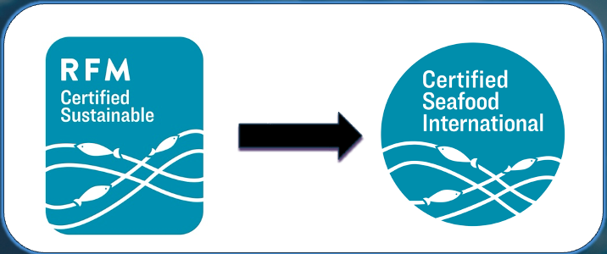
What is CSI?
Credible, cost-effective, and transparent wild-capture certification program alternative with global reach.
Fishery Standard – assesses for environmental responsible fishery management.
Includes chain of custody with the ability to identify harvest origin on the ecolabel.
Notes:
Before I get into the agenda and presentation details, I thought it best to say what CSI is.
Certified Seafood International (CSI) is a credible, cost-effective, and transparent wild-capture certification program alternative with global reach. CSI assesses environmentally responsible fishery management using a rigorous standard grounded in internationally recognized UN FAO guidelines. Our certification includes a robust Chain of Custody with the ability to identify harvest origin on the ecolabel.

Slide 4
RFM had explicitly expanded its scope seeking global growth
Outside of the U.S., RFM viewed as an Alaskan program
RFM >> CSI facilitates acceptance and global growth
Alaska / RFM representation in CSI governance
Shared direction and program attributes
RFM to CSI –Natural and Logical
Notes:
The original idea for choice came from the Responsible Fisheries Management certification program which came into existence in 2013. It started out as a regional program for Alaska, where ASMI and the Alaska industry were intregal in its build, it then expanded to North American and then last year, RFM expanded its scope to assess global fisheries.
However, outside of the US, RFM was viewed as an Alaska only program.
Many potential fishery clients were looking for more market access and wanted choice with global reach.
So here we are where RFM has rolled into CSI, where CSI can now facilitate global growth and acceptance.
We still have Alaska/RFM representation in our CSI governance and shared program attributes.

Slide 5

Smooth, Extended Transition for RFM Clients
 | What’s Changed and What it Means for RFM Clients
Program Name | RFM to Certified Seafood International (CSI)
Current Certificate Holders | No change to certificates or to audit and recertification schedules.
Fishery Standard | Finalizing new standard then enter validation phase. RFM Fisheries Standard read as a regional standard. Changes are to make it more fit for purpose for global applicability of the standard. All fisheries currently certified will meet the revision requirements.
Chain of Custody (CoC) Standard | No change
GSSI Status | Program retains GSSI benchmark.

Slide 6
Smooth, Extended Transition for RFM Clients
 | What’s Changed and What it Means for RFM Clients
Logo Use | Continue to use existing logo until stock depleted. Update over time.
Program Costs | Program funding will transition away from solely RFM fishery clients to partner agreement fees. Determined by annual wholesale value of certified seafood sold/purchased.
Certification Bodies | No change, new CB’s will become available.
Website | CSICERTIFIED.ORG
Points of Contact | Mike Kraft, Jeff Regnart and Tricia Sanguinetti

Slide 7


“Focused on What Matters”
Credibility
GSSI benchmarked program
Fishery Standard based on established UN FAO documents focused on fisheries management
Global, experienced board
No extended conditional certifications
Notes:
CSI is a rigorous program benchmarked by GSSI. In fact just passed our 4th MOCA (monitoring of continued alignment). Our fisheries are certified against a standard grounded in the internationally recognized principles of the UN FAO. These FAO criteria were developed in partnership with the world’s leading fishery biologists, environmental organizations and fishery managers from 70 countries.
Our Fishery Standard does not extend conditional certifications. A fishery either meets the standard or it doesn’t.
We have an experience board representing areas from around the world.

Slide 8
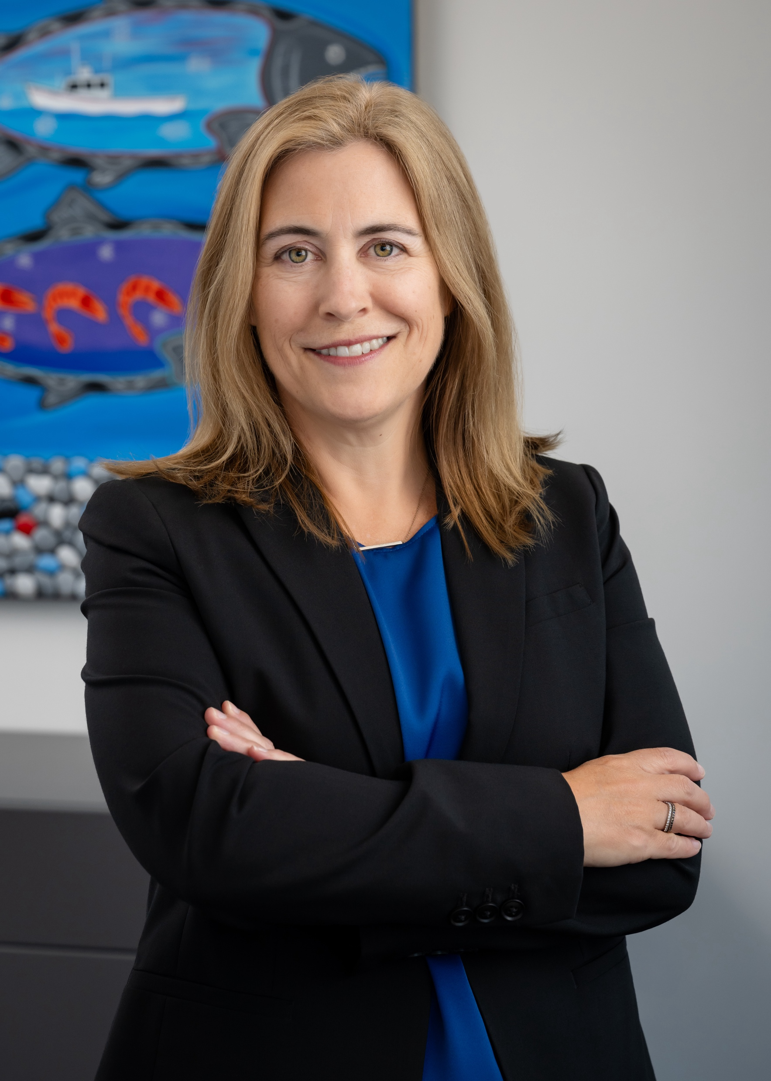

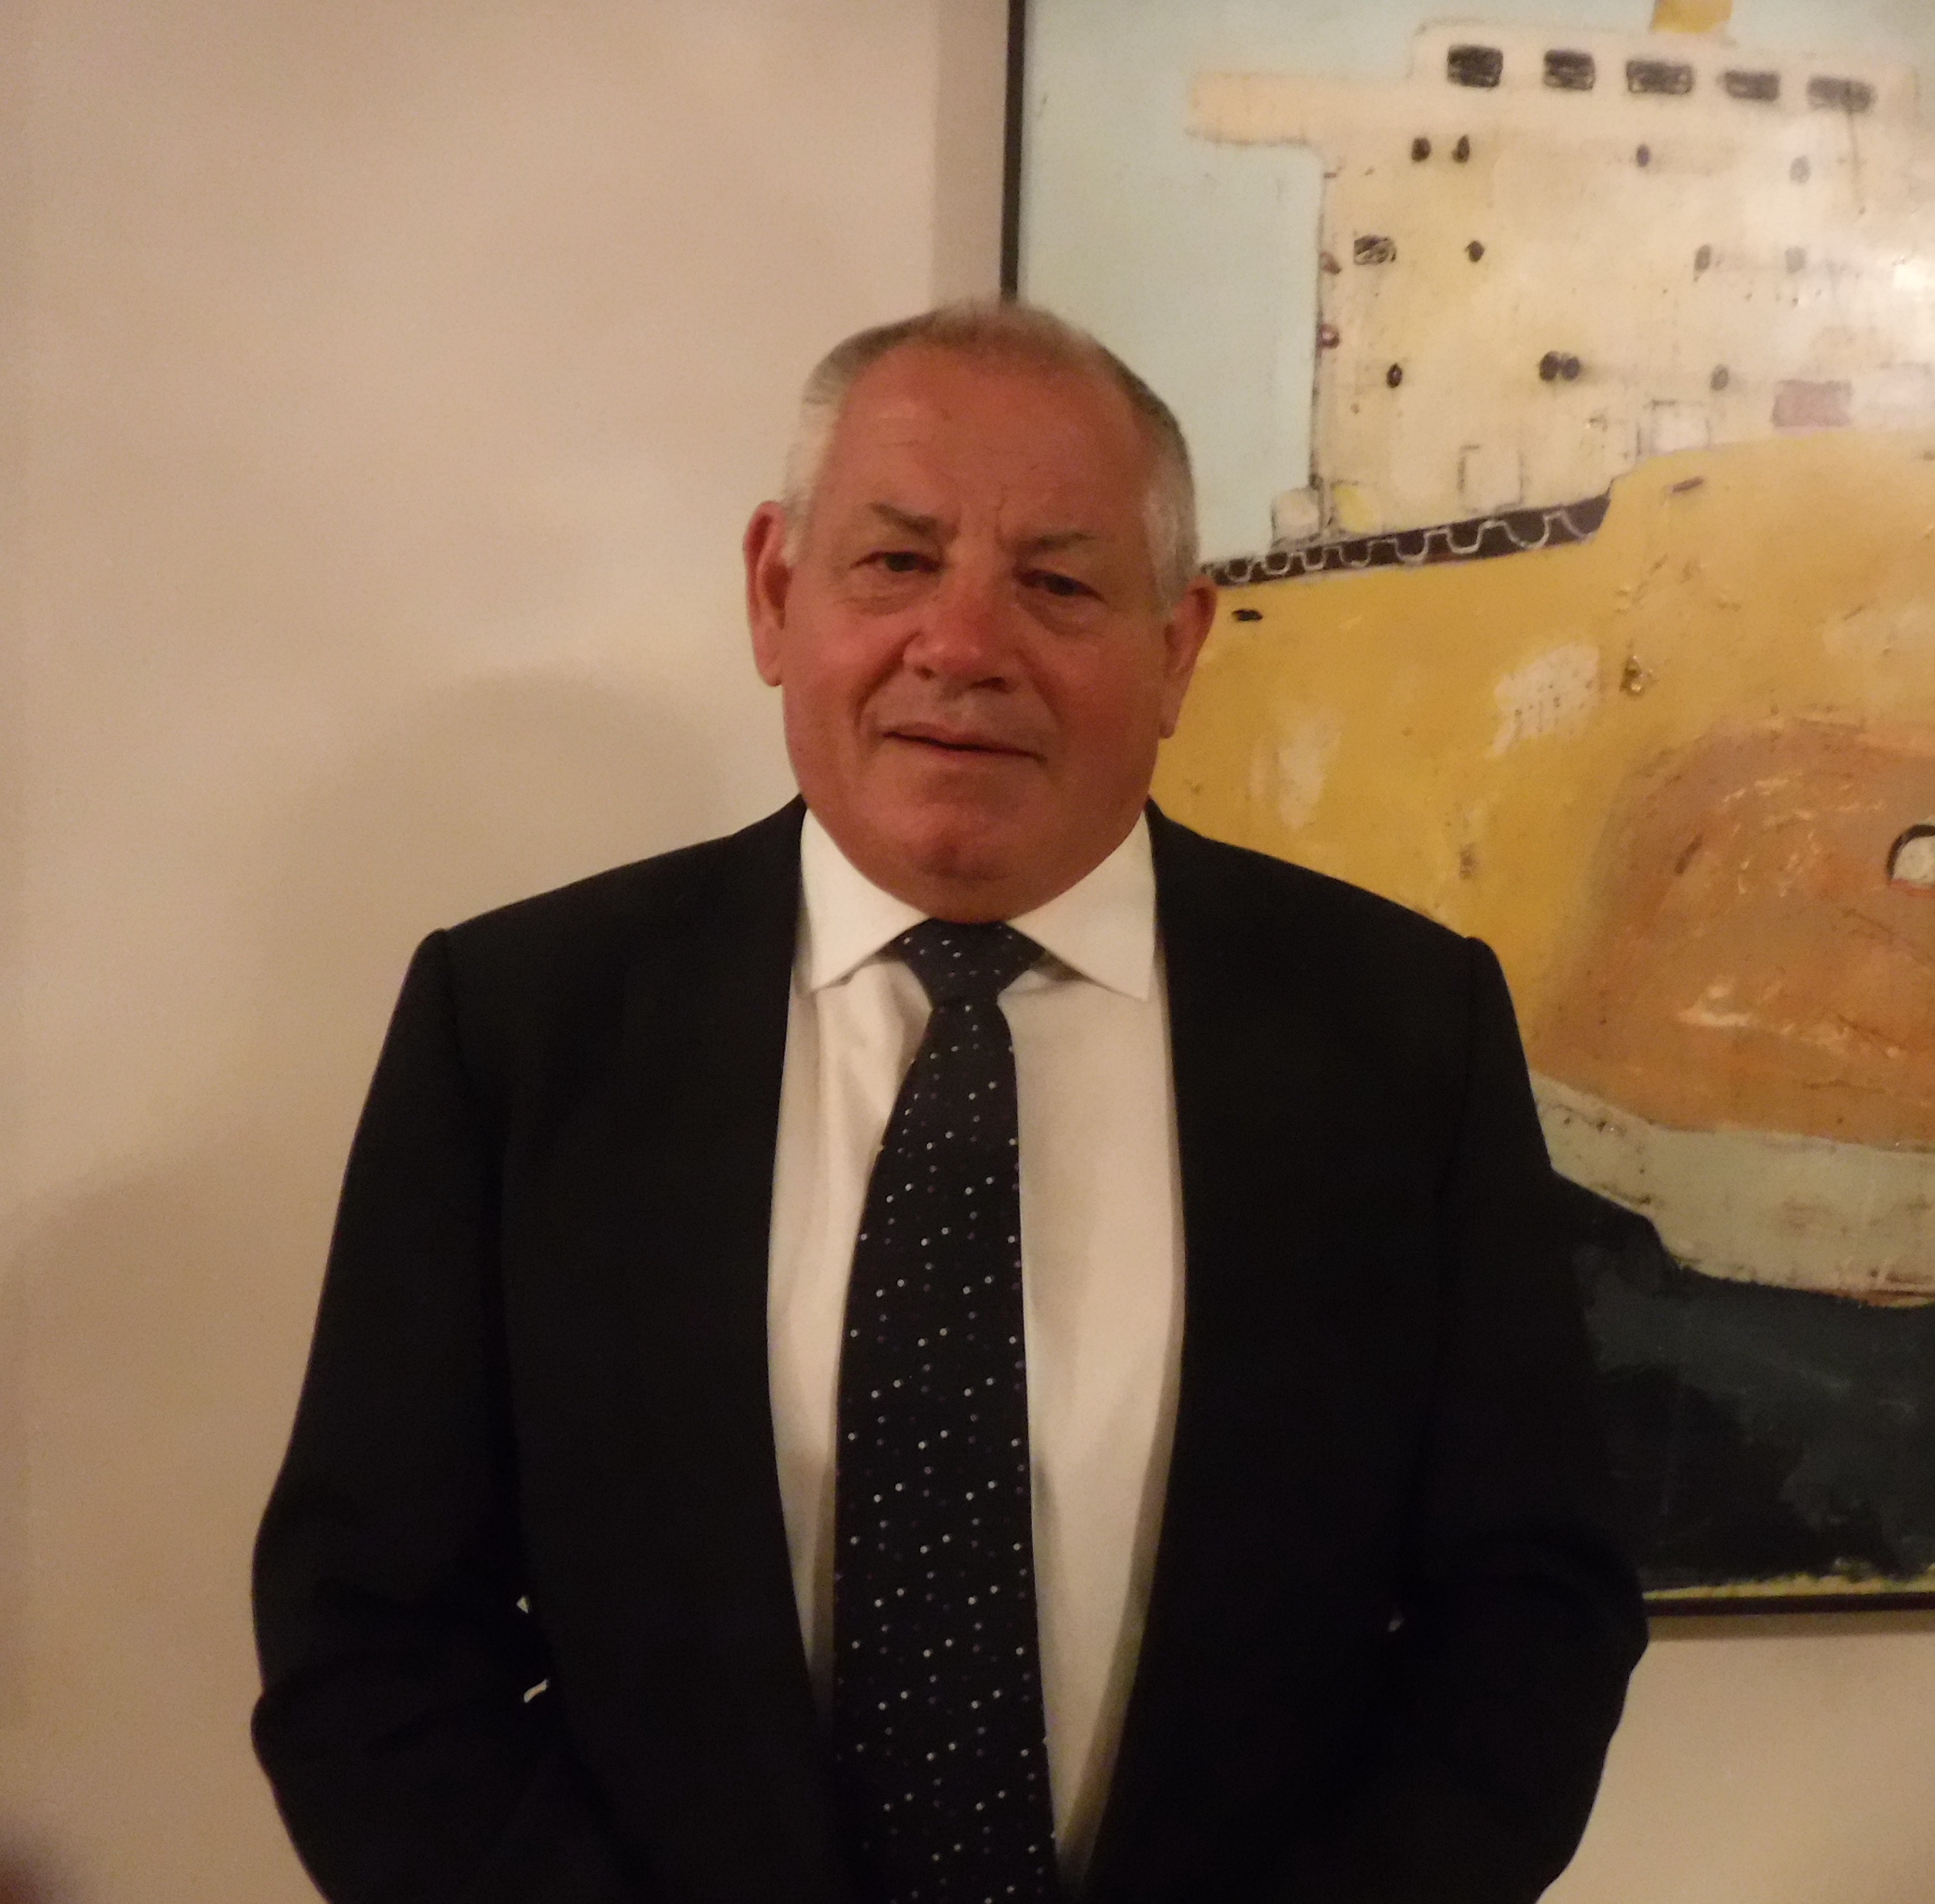
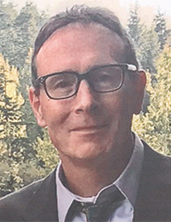

CSI Board
Christine Penney
Sevrine bethy
Tom Birdsall
Mark fina
Jonty Jankovich
Notes:
We have an experienced and impressive board representing organizations from around the world.
Clearwater Seafoods VP of Sustainability and Public Affairs out of Canada
Sodexo, Head of Responsible Sourcing N. America
Associate Director of Seafood New Zealand
Silverbay out of AK, former chair of RFM Board
S. Africa Fisheries and Chairman of the Harvest Sector CEO Council

Slide 9
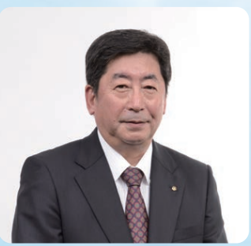





CSI Board
Akiyo Matono
Klaus nielsen
Sally Roach
Matt Tinning
Libby woodhatch
Pedro zapata
Notes:
4 decades with Nissui Group, former president
Klaus former CEO of Espersen big European processor/brand.
Sally is Senior Manager International Sustainability
At Sea Processors, President
MarinTrust, the global standard for Marine Ingredients, Executive Chair
Environmental Defense Fund, Associate Vice President, Global Oceans Strategies at Environmental Defense Fund
Alaska Regional Advisory Group via ASMI’s new Certified Seafood Committee

Slide 10
“Focused on What Matters”
Affordability without compromise
Lean, focused organization
Streamlined Fishery Standard
Significant reductions in fees for ecolabel users
Notes:
We are committed to sharply reducing the cost of selling certified seafood, and our partner program fees are set at a level that covers only the actual operating costs of a streamlined program.
Our Partner Program fees are tiered by sales volume of certified seafood and are at least 70% lower than the published fees of other wild-capture programs.

Slide 11
CSI Partner Program
Entities that package and sell certified CSI seafood in consumer-ready packaging or sell direct to consumers using the CSI claim or ecolabel
Examples
  Brands or final processors of consumer-ready packaged products.
  Entities selling certified seafood in non-consumer packaging direct to consumers.
$500 to $100,000 per year
  Determined by annual wholesale value of certified seafood sold/purchased
  Provides significant savings to ecolabel users
Supply chain entities that reference CSI assurance in B2B transactions or as part of sourcing policy, pay a flat $500 annual fee

Slide 12
Program Fee Scenarios
Brand selling $350 million / yr of frozen packaged certified seafood into retail >>> CSI annual fee = $100,000
Brand selling $50 million / yr of frozen packaged certified seafood into retail >>> CSI annual fee = $40,000
Foodservice distributor selling multi-packs of pre-packaged fillets to restaurants >>> CSI annual fee = $500
Restaurant chain selling certified salmon with CSI ecolabel on menu (wholesale purchase value $4 million/yr) >>> CSI annual fee = $3,000
Retailer selling only consumer-ready packaged products >>> No CSI fee
Primary processor making no CSI claim >>> No CSI fee

Slide 13
“Focused on What Matters”
Global Reach
Build upon the 10 certified fisheries from the RFM program (3 million metric tonnes)
Commitments / interest from fisheries in New Zealand, Canada, South Africa, Norway, Denmark
Shared Chain of Custody with Iceland
Global Certification Bodies
Notes:
CSI has been developed in partnership with existing regional certification programs, and builds upon their successes. Most significantly, the Responsible Fisheries Management (RFM) program has rolled into CSI, allowing us to launch with existing certified fisheries that land approximately three million metric tonnes.

Slide 14
CSI Certified Fisheries
Alaska Black Cod (Sablefish)
Alaska Cod
Alaska Crab
Alaska Flatfish
Alaska Halibut
Alaska Pollock
Alaska Rockfish and Atka Mackerel
Alaska Salmon
Pacific Whiting (hake)
U.S. Gulf Shrimp
Alaska Herring (in assessment)

Slide 15
“Focused on What Matters”
Transparency
Ability to identify harvest origin on logo
Platform for fisheries to share information
Focus on supporting fisheries and brands with assurance, not being the brand
Strong launch supported by targeted online presence
Notes:
CSI believes deeply in the fishing communities that harvest wild-capture seafood, and we want to share their stories with the world. Our program provides more than a generic stamp of approval. We offer a choice to identify harvest origin on the CSI label; and we provide an online platform to communicate a wider range of information about certified fisheries. Through these and other innovations, we work every day to enhance transparency and trust.

Slide 16





Slide 17
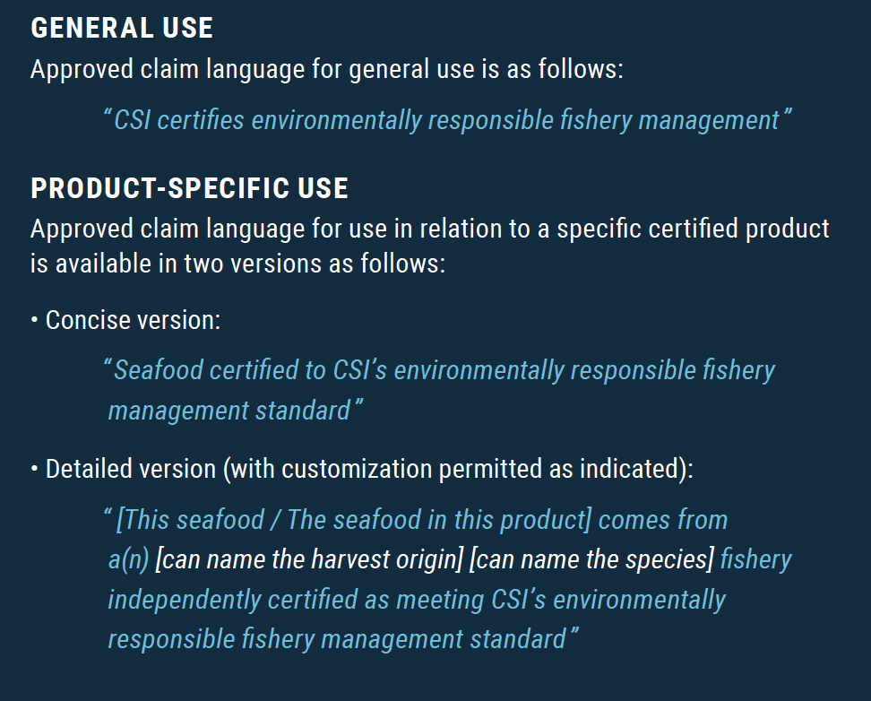
The CSI Claim

Slide 18
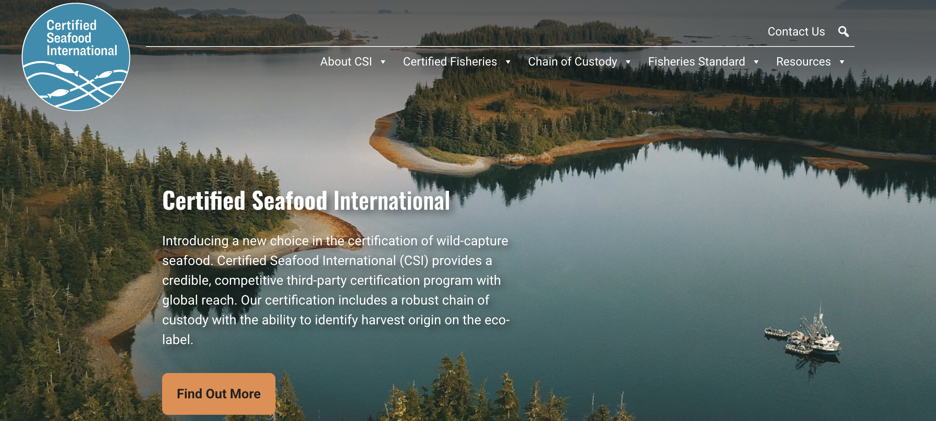
Csicertified.org

Slide 19

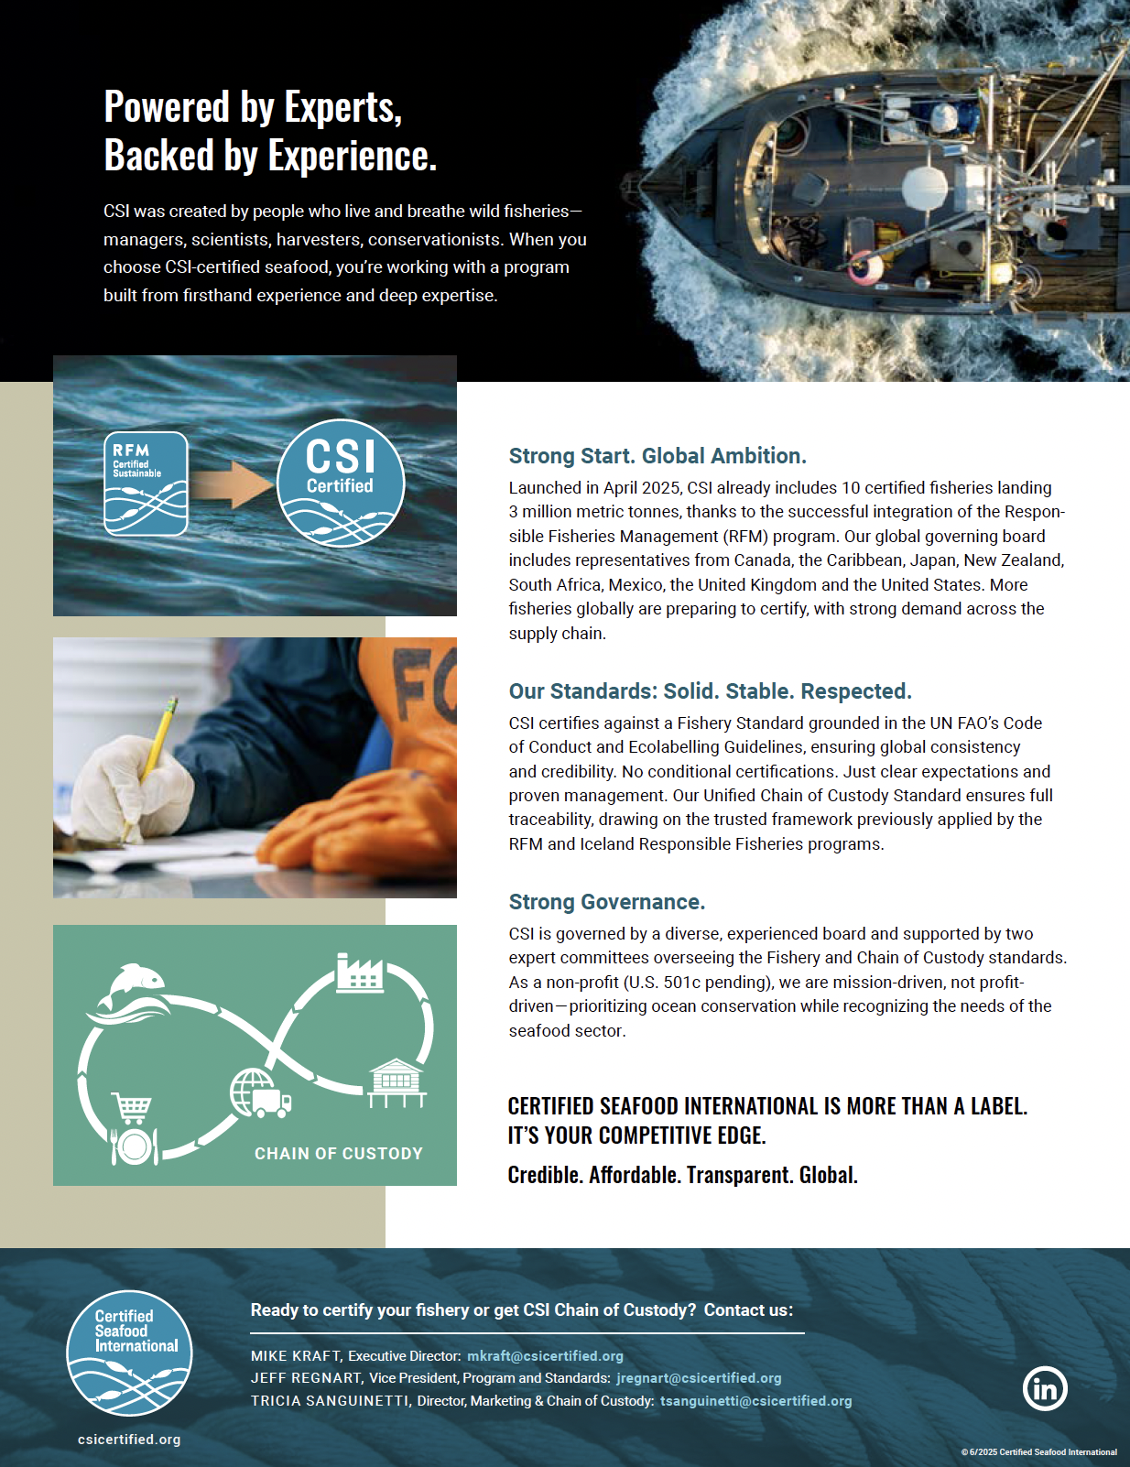
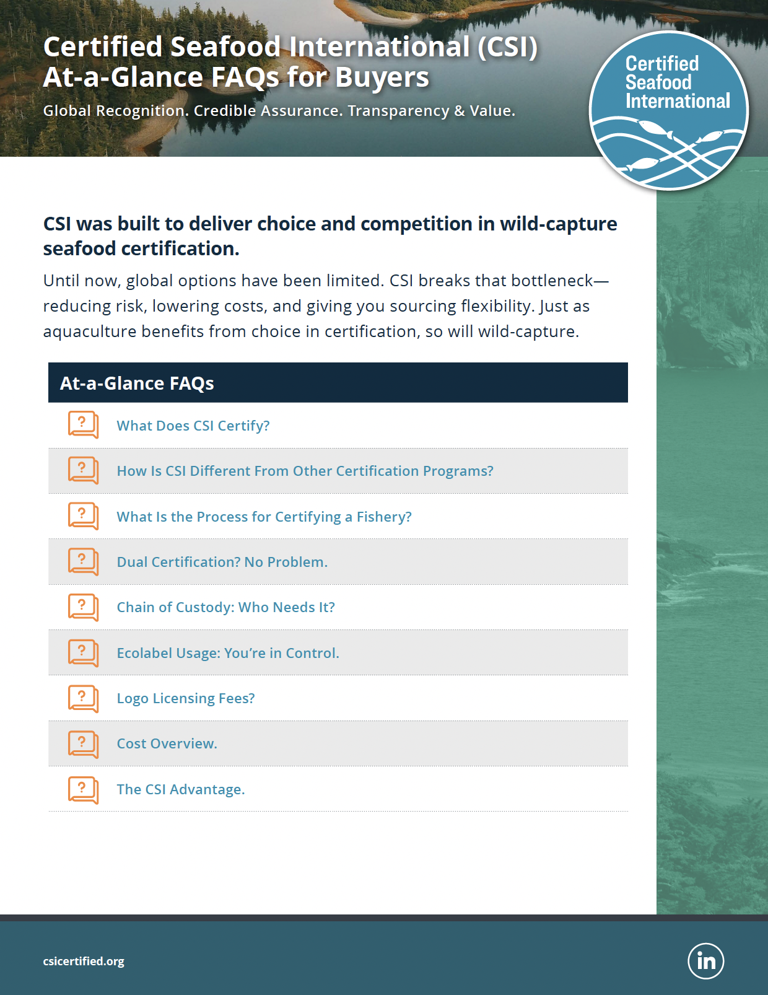
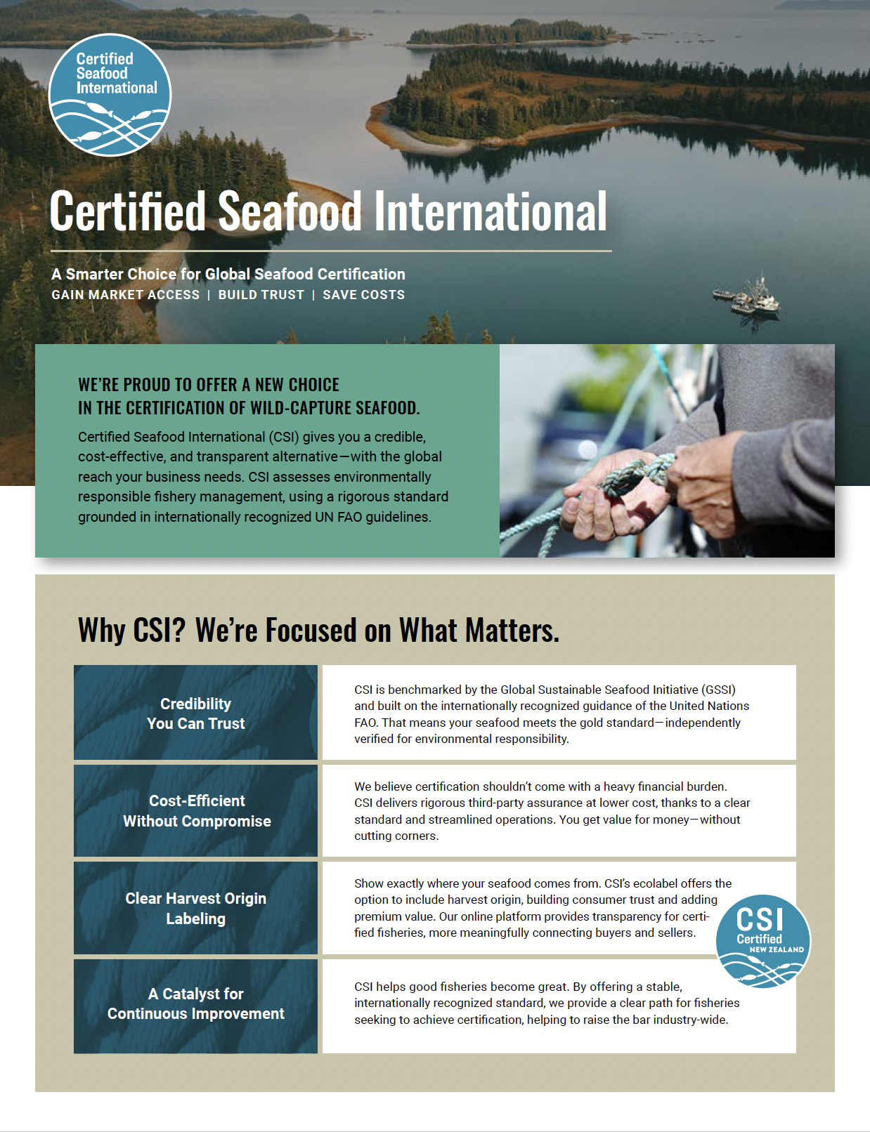
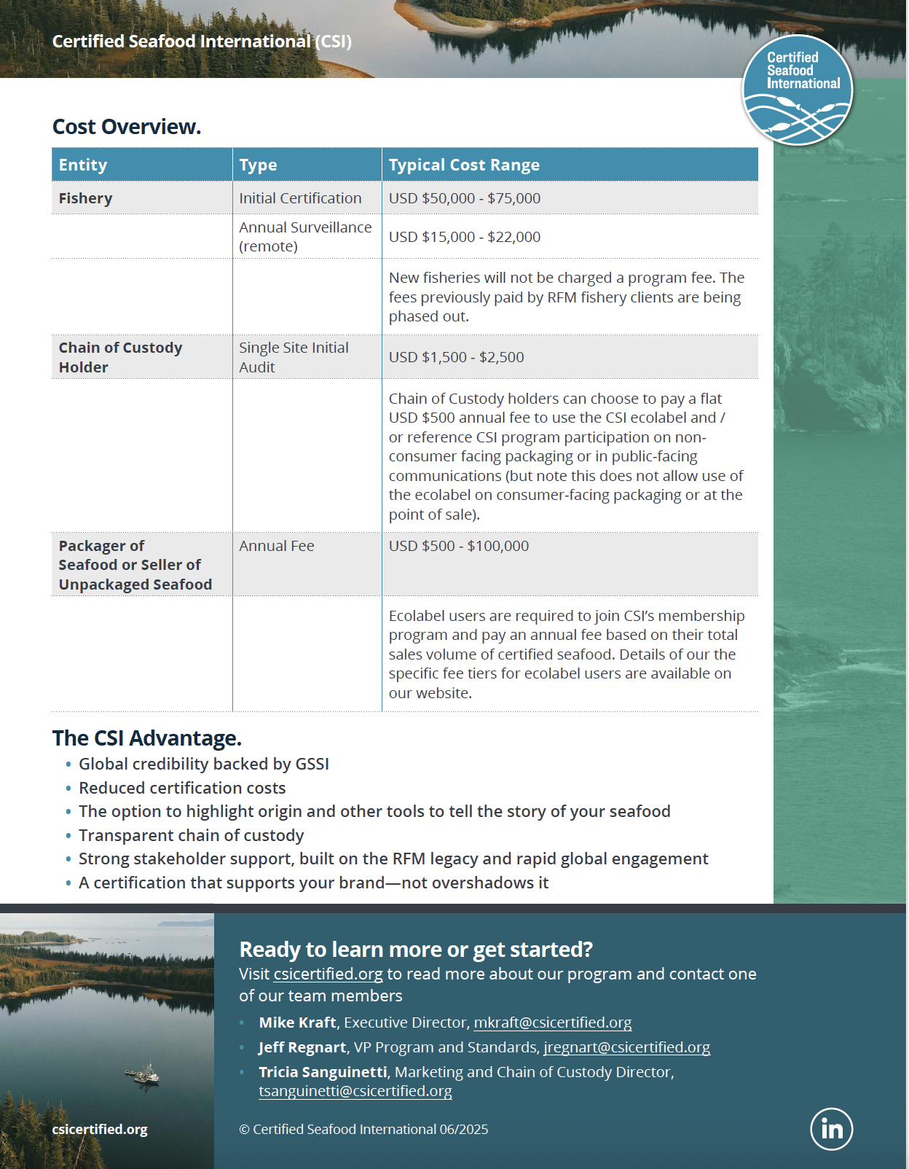

Slide 20

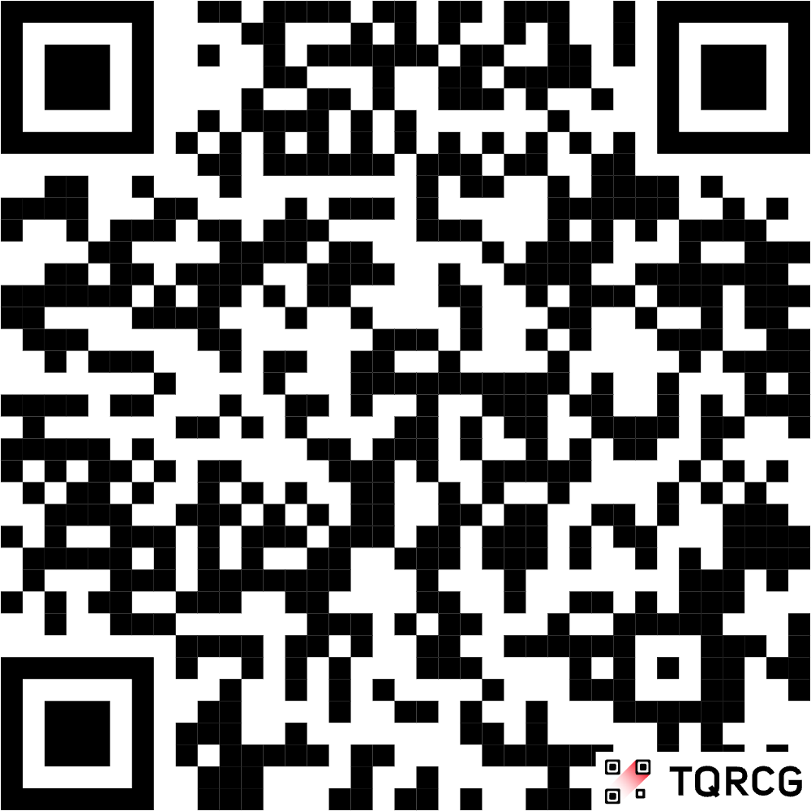
Thank You

