Slide 1
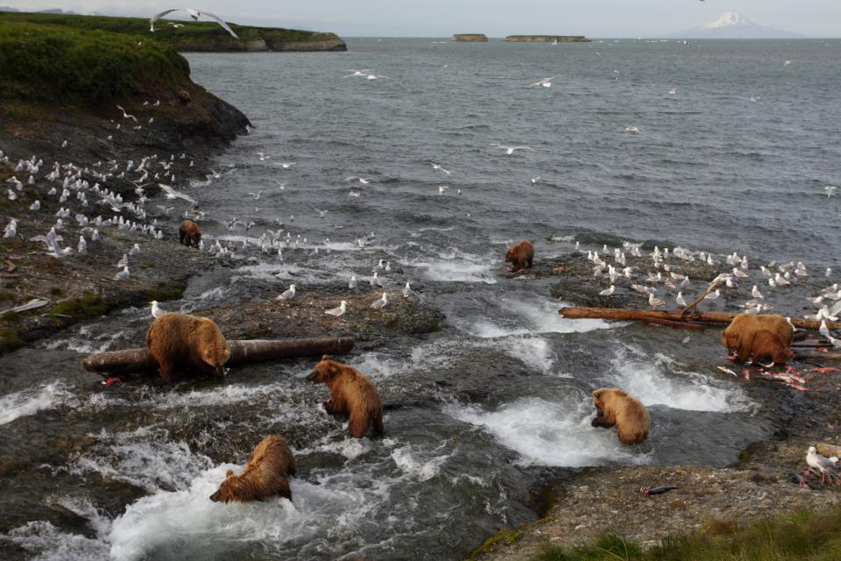
ASMI International
All Hands Meeting
Alexa Tonkovich
October 21, 2015
Anchorage, AK

Slide 2
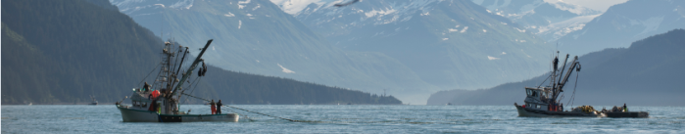

Contents
FY15 Program Recap
Overall Program Goals and Accomplishments
Results, cross-program collaborations, current/upcoming events by region:
China
Japan
Brazil
Northern Europe
Southern Europe
Western Europe
Central Europe
Eastern Europe

Slide 3
FY15 Program Recap
New ASMI International Staff
New Overseas Marketing Representatives in France and Germany
Successful Brussels/Seafood Expo Global
Exhibited at more than 20 international and regional trade shows
Additional funding allocated toward salmon promotion
Hosted delegations from Japan and Germany
Joint International-Communications Culinary Retreat
Adopted new Strategic Annex

Slide 4
FY15 Program Recap
Industry outreach July 2015
EU Strategy Session: In conjunction with a meeting of FAS Europe, ASMI held an EU strategy session for OMRs to discuss collaboration, sharing resources, and best practices.
Results: shared resource link, joint photo session and multi-country ad campaign are in the works.
CAP Recommendation: ASMI should address buyer consolidation in Europe.

Slide 5
Program Goals/Accomplishments
Goal: ASMI will explore possible funding through the FAS Emerging Market Program (EMP) for activities in Southeast Asia.
CAP Recommendation: ASMI should consider targeting development markets in Africa and Asia.
In response to a request for the IMC, the International program applied for and won an EMP grant to explore Southeast Asia. The grant includes Vietnam, Thailand, Indonesia, the Philippines, and Malaysia.
The mission to Southeast Asia will take place in early 2016.

Slide 6
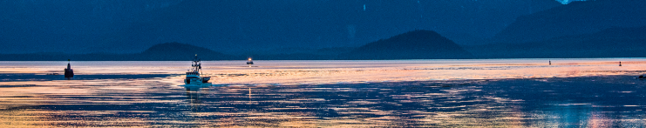
China
Goals:
Promote sole, flounder, pink and chum salmon but also capitalize on demand for sockeye, black cod and crab
Introduce Alaska pollock roe and herring roe to this market
Target local chains as well as fast food/quick service restaurants
Take advantage of expanding e-commerce opportunities

Slide 7
Activity Highlight:
Online sales promotions with JD and YHD.com in 2015
ASMI China launched Alaska seafood online promotions with JD and YHD, two of the major B2C e-commerce industry players.
Promotions highlighted a wide variety of Alaska seafood including king crab, snow crab, salmon, black cod, Pacific cod, yellowfin sole, pollock, pollock roe, POP, shrimp and sea cucumber.

Slide 8
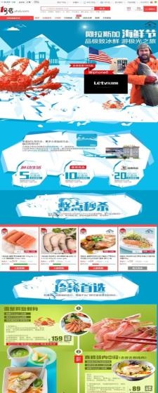
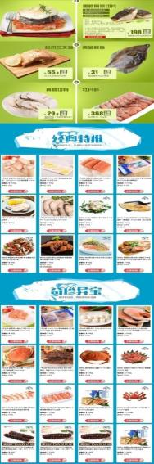
Results: Combined sales volume of $1 million USD. Promotions were at a minimal cost to ASMI, $5,000 each.
Results: Cumulative online sales of $83 million for FY15
Notes:
Cumulative online sales promotion results $83 million USD

Slide 9
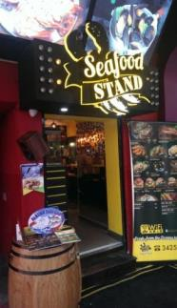
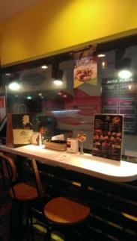
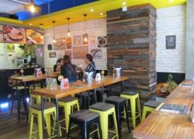
Activity Highlight:
Alaska Seafood Promotion with Seafood Stand, a chain restaurant in HK serving western-style fast food.
Results:
4,120kg Alaska seafood was sold during the promotion, worth US $167,479.
Due to the success of the promotion, Alaska cod and black cod are now on the permanent menu.
Notes:
$6,000

Slide 10

Japan
Goals:
Differentiate Alaska pollock roe and surimi
Encourage new product development and development of recipes for traditional products geared toward younger generations.
Activity Example:
ASMI created an educational page titled “Kirimi-chan goes to Alaska to learn about surimi production.
Kirimi-chan are a group of popular, cute characters produced by Sanrio. There are 10 seafood characters.
The official Kirimi-chan Twitter account currently has about 240,000 followers and it is connected to their official homepage.
The page introduces viewers to key information about Alaska pollock surimi, which helps general consumers, and also the younger generation of the seafood industry to understand Alaska pollock and Alaska pollock surimi.

Slide 11
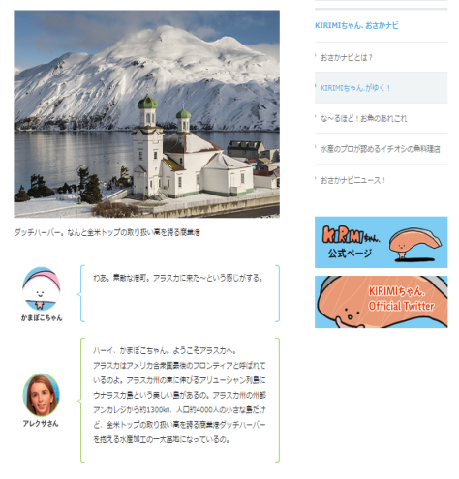
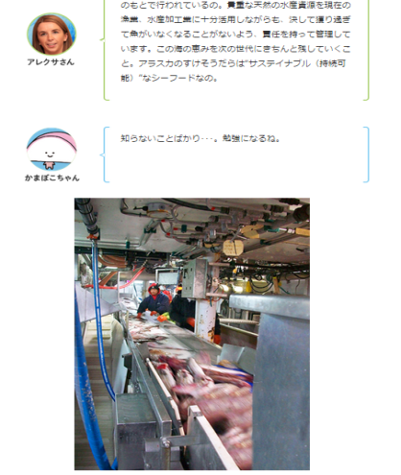

Slide 12
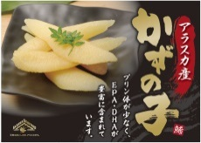
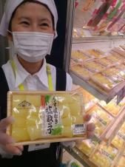
Goals:
Place emphasis on products needing attention due to market conditions (cod, herring roe, rock sole with roe, etc.)
Appeal to traditional Japanese customs and the importance of Alaska seafood products to traditional Japanese cuisine.
Activity Example:
ASMI produced a variety of POS specifically targeting herring roe sales which industry can order through the website.
Ito-Yokado: Alaska Herring Roe Promotion
Sales pitches included Alaska key messages & how to enjoy herring roe
Nutritional benefit of eating herring roe described on POS materials
Results: 12 MT of Herring Roe sold at Ito Yokado alone

Slide 13
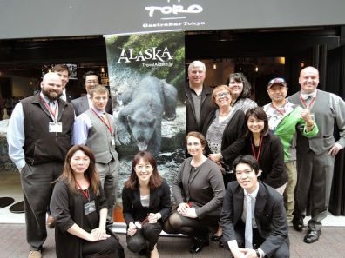
Goal: Capitalize on opportunities to align with Alaska tourism marketing
Activity Example:
ASMI Japan collaborated with the State of Alaska Tourism Office to support its Japan Sales Mission in April 2015.
The purpose of ASMI’s support was to promote and educate the Japanese travel industry (as general consumers) and media about Alaska seafood and present them with opportunities to taste real Alaska seafood.
ASMI Japan provided a lunch including various kinds of Alaska seafood, including: sockeye salmon, salmon roe, herring roe, Alaska pollock roe, POP, black cod, rock fish, Pacific cod, rock sole, yellowfin sole, king crab and snow crab.
Chefs developed and prepared original recipes for the special menu.

Slide 14
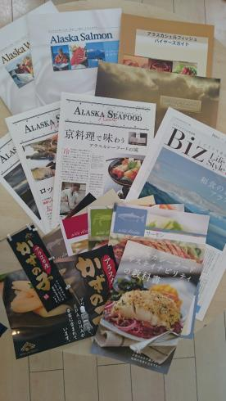
Cross-Program Collaborations:
Attendance at the China Fisheries Show
Sharing Japanese materials and traditional Japanese recipes with EU programs
Worked with Communications Program to coordinate a trip through NHK Japan for commercial fisherwoman Melanie Brown for a show highlighting seafood industry members from around the world.

Slide 15
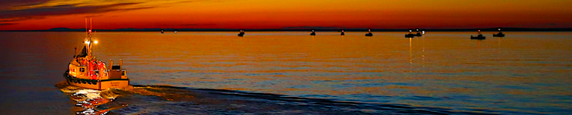
Brazil
Goals: Work with top retailers in major cities as well as select restaurants
Build partnerships with key importers and processors
Place emphasis on cod but build the Alaska brand with all species available
Build awareness of Alaska and Alaska brand within this new market

Slide 16
Activity Example: Japan Food Show
ASMI exhibited at the Japan Food Show that took place in São Paulo from August 3 to 5, 2015.
This was the first edition of the show, which targeted Japanese and Asian restaurants and chefs.
Workshops on best practices and seafood industry trends, and culinary classes displaying exhibitors’ products were offered by organizers.
ASMI participated in the Seafood Forum to talk about the use of wild salmon and other wild species in Japanese Gastronomy.
The show generated more than 360 leads, including restaurant owners, importers/distributors, chefs, media, and associations.

Slide 17
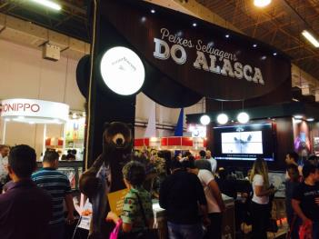
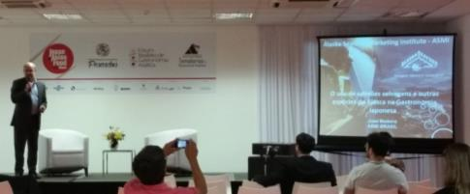
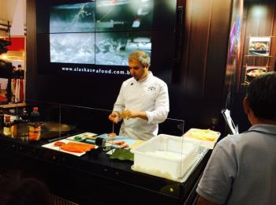
Presentation on the use of wild salmon and other wild species in Japanese Gastronomy
ASMI booth
Japanese Cooking class held at ASMI booth with Sushiman Sassá of Sassá Sushi Restaurant

Slide 18
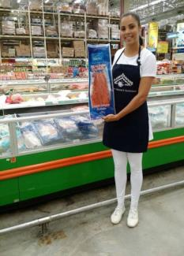
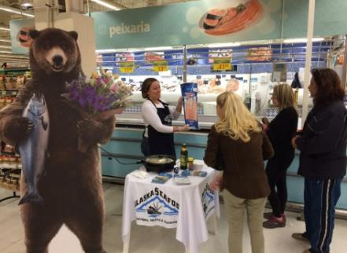
Activity Example:
ASMI Brazil organized retail promotions in 29 outlets of six major retail chains in the cities of São Paulo, Rio de Janeiro, Belo Horizonte, Criciúma, São José and Florianópolis.
Sales of 13.72 MT of Alaska products (Alaska chum, pink and sockeye salmon, pollock and cod) were reported last year.
Increased consumer awareness about seafood from Alaska and its characteristics

Slide 19
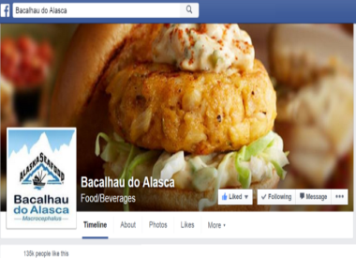
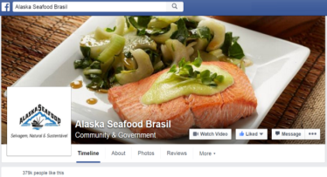
Cross-Program Cooperation:
Japan Food Show generated five cooking demonstration videos to be used as an online marketing tool and shared with other ASMI offices and Alaska industry.
Brazil Rep Jose Madeira visited the CONXEMAR Show in Vigo, Spain.
Brazil has shared successful Facebook techniques with other programs at the OMR strategy session.

Slide 20
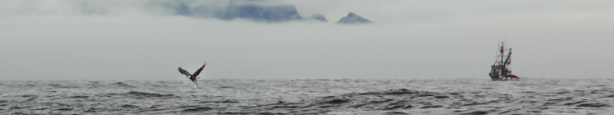
Northern Europe
Goal: Position Alaska canned salmon as a shelf-stable, non-perishable, and often economical seafood product.
Activity Example:
To support sales of sockeye, Princes and ASMI ran a campaign to drive online and in store sales. The online targeting allowed us to maximise investment, target more retailers and deliver measurable uplift.
Sainsbury ran a three week online cross sell with complementary products and used online banners to attract shoppers
Tesco online used special offers and an Easter feature
An in-store promotion with product sampling took place at Sainsbury stores

Slide 21
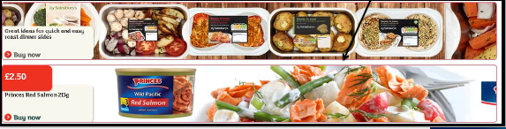
Sainsbury’s online promotion (retailer supported discount) generated $15,000+ sales, +363% during promotion and 119% post promotion.
The cross-sell was the best performing media over the two week cycle – 1,591 cart additions.
Notes:
Canned salmon promotions were also run in Ireland and the Netherlands

Slide 22

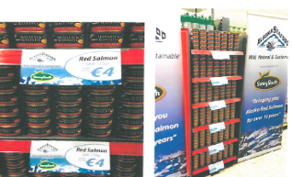
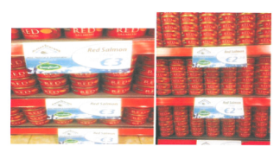
Activity example:
Dunnes is a leading retailer in Ireland with over 100 stores across the republic.
The promotion featured in-store merchandising in the form of shelf talkers and banners with ASMI branding promoting the sale of canned red salmon.
The promotion ran from April 29 – June 30th across three promotion cycles and three can sizes.
In total, around 1,000 cases were sold during the promotional cycle

Slide 23
Goal: PR focuses on targeting the trade and consumer on the sustainability of Alaska pollock
Activity Example: School lunch tie in with the foodservice sector of Young’s Seafood
Three month campaign targeting school lunch programs including print advertorials, advice columns, and materials for an Education Catering event.
Results: E-mail blasts reaching 37,000 schools
Results: Total reach of over 55,000
ASMI and Youngs are in negotiations to partner on this effort again this year.

Slide 25
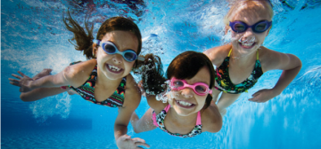
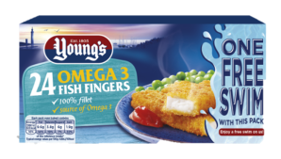
Activity Example: Promotion offering a free swim on packs of Young’s Omega 3 Fish Fingers
Messaging promotes a healthy, active lifestyle, universal appeal (adults and children included in the ‘Free Swim’ offer)
‘Free Swim’ promotional website has a “swim to Alaska” theme
On-pack promotion on 6 million packs over 12 months featuring ASMI logo
Grand prize drawing for an Alaska holiday
ASMI support includes customer newsletter, social media campaigns, etc.
Expected uplift of 5% (additional 300,000 packs sold)

Slide 26
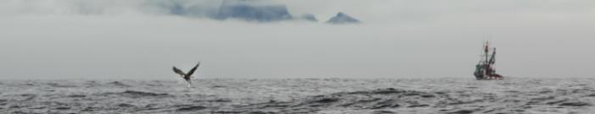
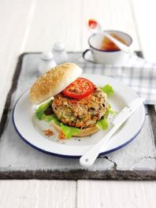
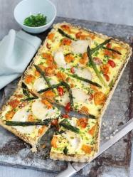
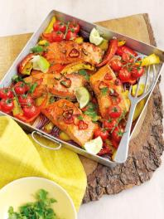
Cross-program collaboration:
The NEU program supported the RFM program at the World Seafood Congress in Grimsby, UK. ASMI arranged for Alaska Pacific cod to be served at the gala dinner, created banners for the event and helped to man the booth.
ASMI UK program created a platform to share photography and recipes with other ASMI programs
Cajun salmon burger
Alaska salmon and goat cheese tart
Alaska Firecracker salmon

Slide 27
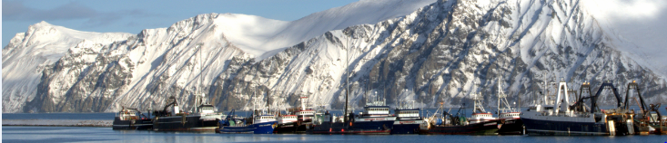
Southern Europe
Goal: Connect Alaska origin with Alaska cod
Activity Example:
Alaska Cod promotions in Italy (March 23 – April 20, 2015): ASMI SEU and distributor Pambuffetti conducted an in-store promotion of salted Baccalà d’Alaska fillets to a small sample of Pambuffetti’s many independent retail customers.
The salted fillets were packaged in a re-usable polypropylene bag, and pop-up banners were placed in or outside of each point of sale announcing the Alaska cod promotion.

Slide 28
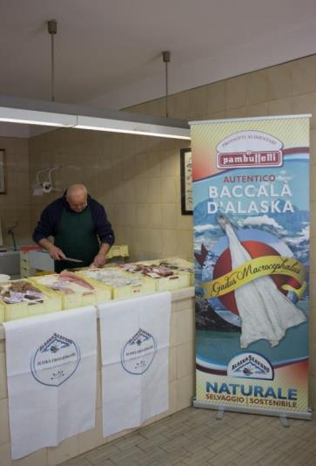
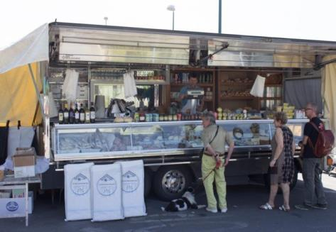
Results: Five store days of Alaska seafood promotions generated a 66% increase
over previous periods.

Slide 29

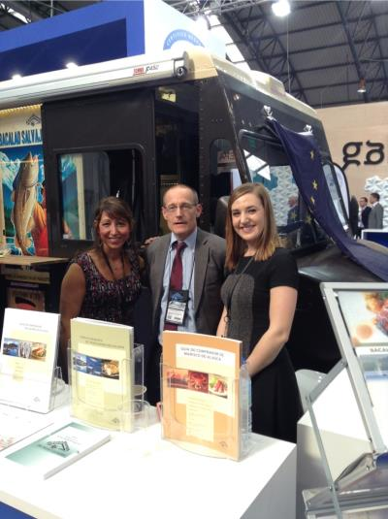
Goal: Focus on origin identification
Goal: Encourage acceptance of Alaska RFM
Activity Example:
Conxemar 2015- ASMI sponsored food truck drives sales of Alaska product and creates strong origin identity
Sustainability Officer on hand at Conxemar show

Slide 30
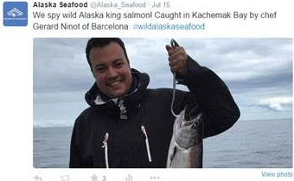
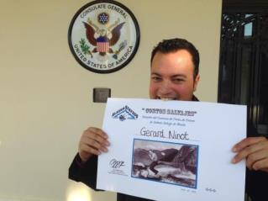
Cross program collaboration:
Chef Gerard Ninot won the SEU salmon video contest and attended the ASMI culinary retreat, put on in collaboration with the Communications program.
SEU program gained resources from ASMI Japan and shared ideas on outreach to sushi restaurants with other EU OMRs

Slide 31
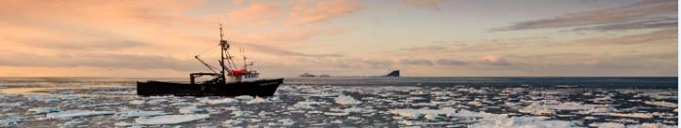
Western Europe
Goals (as outlined by Golin- new OMR)
Improve image perception
while securing business relationships and volumes.
Emerge in a competitive landscape
while limiting costs and facing more powerful competitors.
Address specific targets’ motivations and needs
while assuring branding consistency.

Slide 32
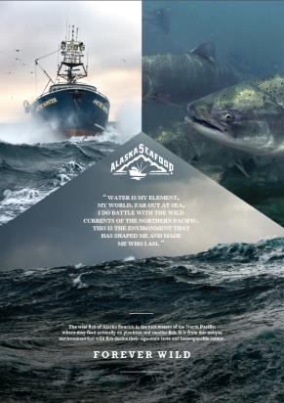

Activity examples:
Upcoming launch of Forever Wild ad campaign
Media buys in targeted magazines
In connection with in-store promotions- Offering top 100 retailers "high potential" tastings and animation, introducing consumers to Alaska seafood products and stimulate sales.
December start time to capitalize on holiday period
Promotions will spread to Belgium.

Slide 33
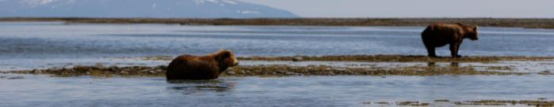
Central Europe
Goal: Develop a strong connection with Alaska Seafood’s sustainability message
Activity Example: German Press Tour August 2015
ASMI and Gottfried Friedrichs, producers of two brands of smoked Alaska salmon, partnered on a three-month promotional campaign in German retail stores and online
Over 300,000 retail units of Alaska smoked salmon were sold with special packaging, advertising a campaign blog and an opportunity to, ‘Win a trip to Alaska.’ Sales during the promotion more than quadrupled normal sales, reaching $2.3 million in three months.
In August the group visited Ketchikan, Juneau and Kodiak, touring plants, meeting with industry and fisheries managers.

Slide 34
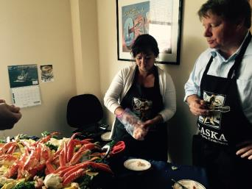
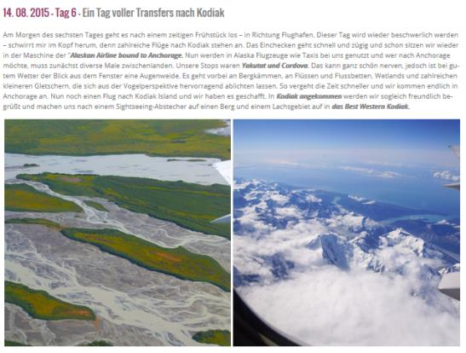
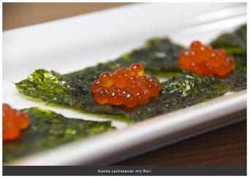
Cross Program Collaboration: Sustainability Officer accompanied the trip and sustainability messaging was woven in throughout

Slide 35
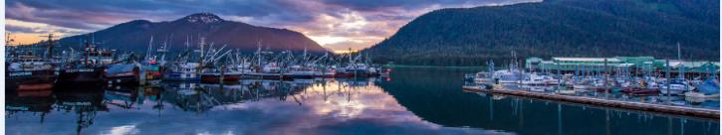
Eastern Europe
Goals: Explore opportunities in other Eastern European markets
Build awareness of Alaska Seafood through POS material translation and development
Activity Examples:
Market research Kazakhstan, Azerbaijan
World Food Kazakhstan (visit)
Trade visit Almaty, Kazakhstan
Trade visit Baku, Azerbaijan
World Food Azerbaijan (exhibit)
Translation of materials into other languages

Slide 36
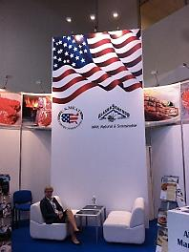
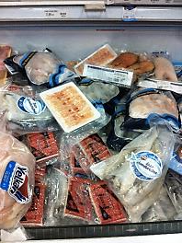
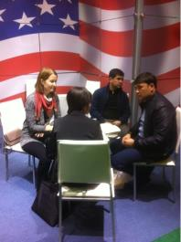
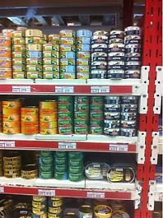
Outreach includes retail store checks and HRI sector visits.
Communication with local FAS offices and professional media.
Attendance at or participation in regional trade shows.

Slide 37
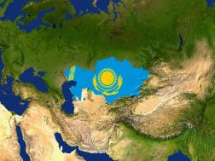

Upcoming:
Trade events in Kazakhstan and Azerbaijan with the U.S. diplomatic mission
Visit trade shows in new markets, including: Georgia (AgroFood, Tbilisi, November), Romania (Agraria, Cluj Napoca, April), Armenia (ExpoFood, Yerevan, September), Moldova.
Continuation of market research, trade lead collection, and database development

Slide 38

Upcoming events:
China Fisheries Show Nov. 4-6 in Qingdao
ASMI China Trade Reception in Qingdao
“Forever Wild” campaign launch in Europe to coincide with the Christmas season
Market Research for Korea expected in Spring
Thank you!!!

